Slide 1


Slide 2

Day 1: Agenda
Pivots
Data Analysis In Excel - Trends, Patterns
Data Visualization In Excel - Column Charts, Line Charts, Pie Charts, Bar Charts, Area Charts, Scatter Plots
Working With Multiple Worksheets
Linking & Referencing The Data Between Worksheets

Slide 3
Pivot Tables
Pivot tables are a powerful data analysis tool in Excel used to summarize, analyze, and visualize data from a larger dataset.
They allow you to reorganize and extract insights from your data quickly.
Creating a Pivot Table:
Select Data: Highlight the dataset you want to use for the pivot table.
Insert Pivot Table: Go to the "Insert" tab and click on "PivotTable."
Choose Data Range: Ensure Excel recognizes your data range. Adjust if necessary.
Design the Pivot Table: Drag and drop fields into the "Rows" and "Values" areas. For example, you can use a sales dataset to summarize sales by region.
Customize: You can customize your pivot table with various options, such as filters, sorting, and calculations
Notes:
# Question 1: if statement
number = int(input("Enter a number: "))
if number > 0:
print("The number is positive.")
# Question 2: if-else statement
age = int(input("Enter your age: "))
if age >= 18:
print("You are eligible to vote.")
else:
print("You are not eligible to vote.")
# Question 3: if-elif-else statement
score = int(input("Enter your test score: "))
if score >= 90:
print("Your grade is A.")
elif score >= 80:
print("Your grade is B.")
elif score >= 70:
print("Your grade is C.")
elif score >= 60:
print("Your grade is D.")
else:
print("Your grade is F.")
# Question 4: Nested conditional statements
number = int(input("Enter a number: "))
if number > 0:
if number % 2 == 0:
print("The number is even and positive.")
else:
print("The number is odd and positive.")
elif number < 0:
if number % 2 == 0:
print("The number is even and negative.")
else:
print("The number is odd and negative.")
else:
print("The number is zero.")

Slide 4
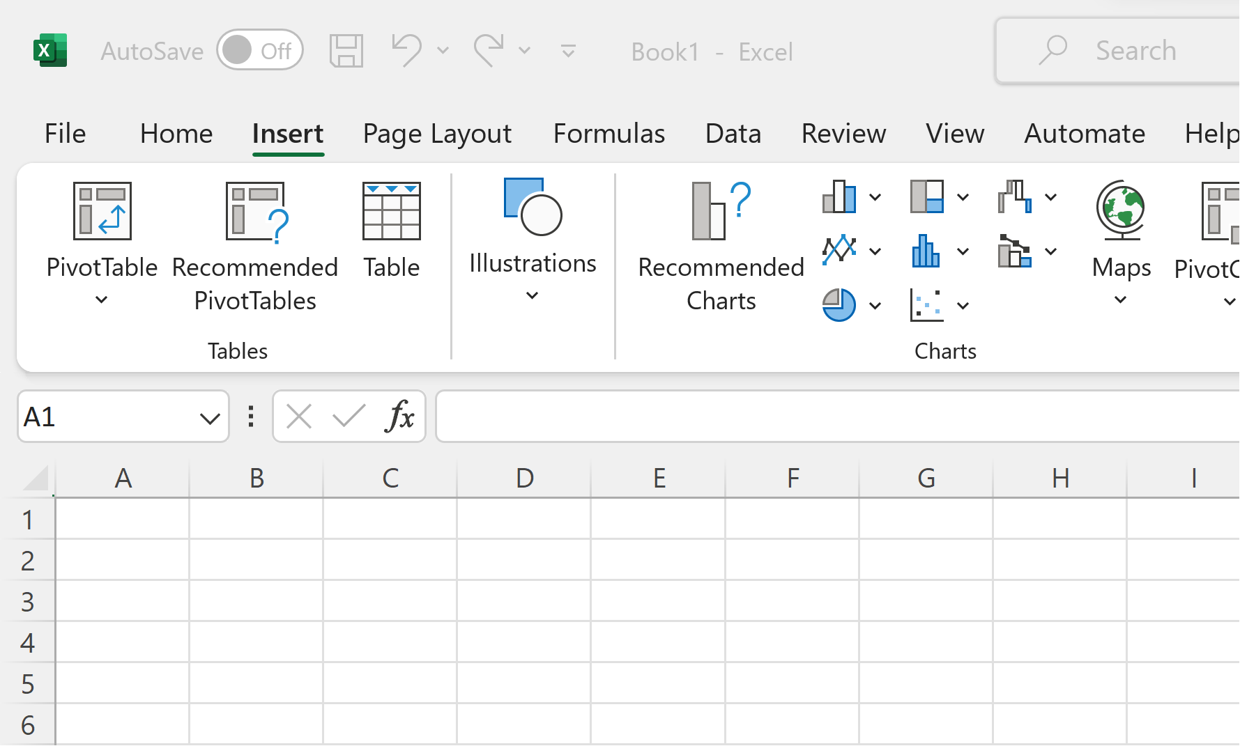
Pivot Tables
Notes:
# Question 1: if statement
number = int(input("Enter a number: "))
if number > 0:
print("The number is positive.")
# Question 2: if-else statement
age = int(input("Enter your age: "))
if age >= 18:
print("You are eligible to vote.")
else:
print("You are not eligible to vote.")
# Question 3: if-elif-else statement
score = int(input("Enter your test score: "))
if score >= 90:
print("Your grade is A.")
elif score >= 80:
print("Your grade is B.")
elif score >= 70:
print("Your grade is C.")
elif score >= 60:
print("Your grade is D.")
else:
print("Your grade is F.")
# Question 4: Nested conditional statements
number = int(input("Enter a number: "))
if number > 0:
if number % 2 == 0:
print("The number is even and positive.")
else:
print("The number is odd and positive.")
elif number < 0:
if number % 2 == 0:
print("The number is even and negative.")
else:
print("The number is odd and negative.")
else:
print("The number is zero.")

Slide 5
Pivot Tables
Modifying Pivot Tables:
You can modify a pivot table by adding or removing fields, changing the layout, or applying different calculations.
Filtering and Sorting Data:
Pivot tables offer easy filtering and sorting options to focus on specific data points.
Notes:
# Question 1: if statement
number = int(input("Enter a number: "))
if number > 0:
print("The number is positive.")
# Question 2: if-else statement
age = int(input("Enter your age: "))
if age >= 18:
print("You are eligible to vote.")
else:
print("You are not eligible to vote.")
# Question 3: if-elif-else statement
score = int(input("Enter your test score: "))
if score >= 90:
print("Your grade is A.")
elif score >= 80:
print("Your grade is B.")
elif score >= 70:
print("Your grade is C.")
elif score >= 60:
print("Your grade is D.")
else:
print("Your grade is F.")
# Question 4: Nested conditional statements
number = int(input("Enter a number: "))
if number > 0:
if number % 2 == 0:
print("The number is even and positive.")
else:
print("The number is odd and positive.")
elif number < 0:
if number % 2 == 0:
print("The number is even and negative.")
else:
print("The number is odd and negative.")
else:
print("The number is zero.")

Slide 6
Pivot Tables
Superstore Dataset: Practical Excercise
Content: A fictional sales dataset often used for data analysis and learning.
Data Categories: Covers orders, products, customers, sales, and profits.
Temporal Scope: Spans multiple years for time-based analysis.
Geographical Scope: Diverse, allowing regional or geographical comparisons.
Data Size: Typically includes thousands of rows for comprehensive analysis
Notes:
# Question 1: if statement
number = int(input("Enter a number: "))
if number > 0:
print("The number is positive.")
# Question 2: if-else statement
age = int(input("Enter your age: "))
if age >= 18:
print("You are eligible to vote.")
else:
print("You are not eligible to vote.")
# Question 3: if-elif-else statement
score = int(input("Enter your test score: "))
if score >= 90:
print("Your grade is A.")
elif score >= 80:
print("Your grade is B.")
elif score >= 70:
print("Your grade is C.")
elif score >= 60:
print("Your grade is D.")
else:
print("Your grade is F.")
# Question 4: Nested conditional statements
number = int(input("Enter a number: "))
if number > 0:
if number % 2 == 0:
print("The number is even and positive.")
else:
print("The number is odd and positive.")
elif number < 0:
if number % 2 == 0:
print("The number is even and negative.")
else:
print("The number is odd and negative.")
else:
print("The number is zero.")

Slide 7
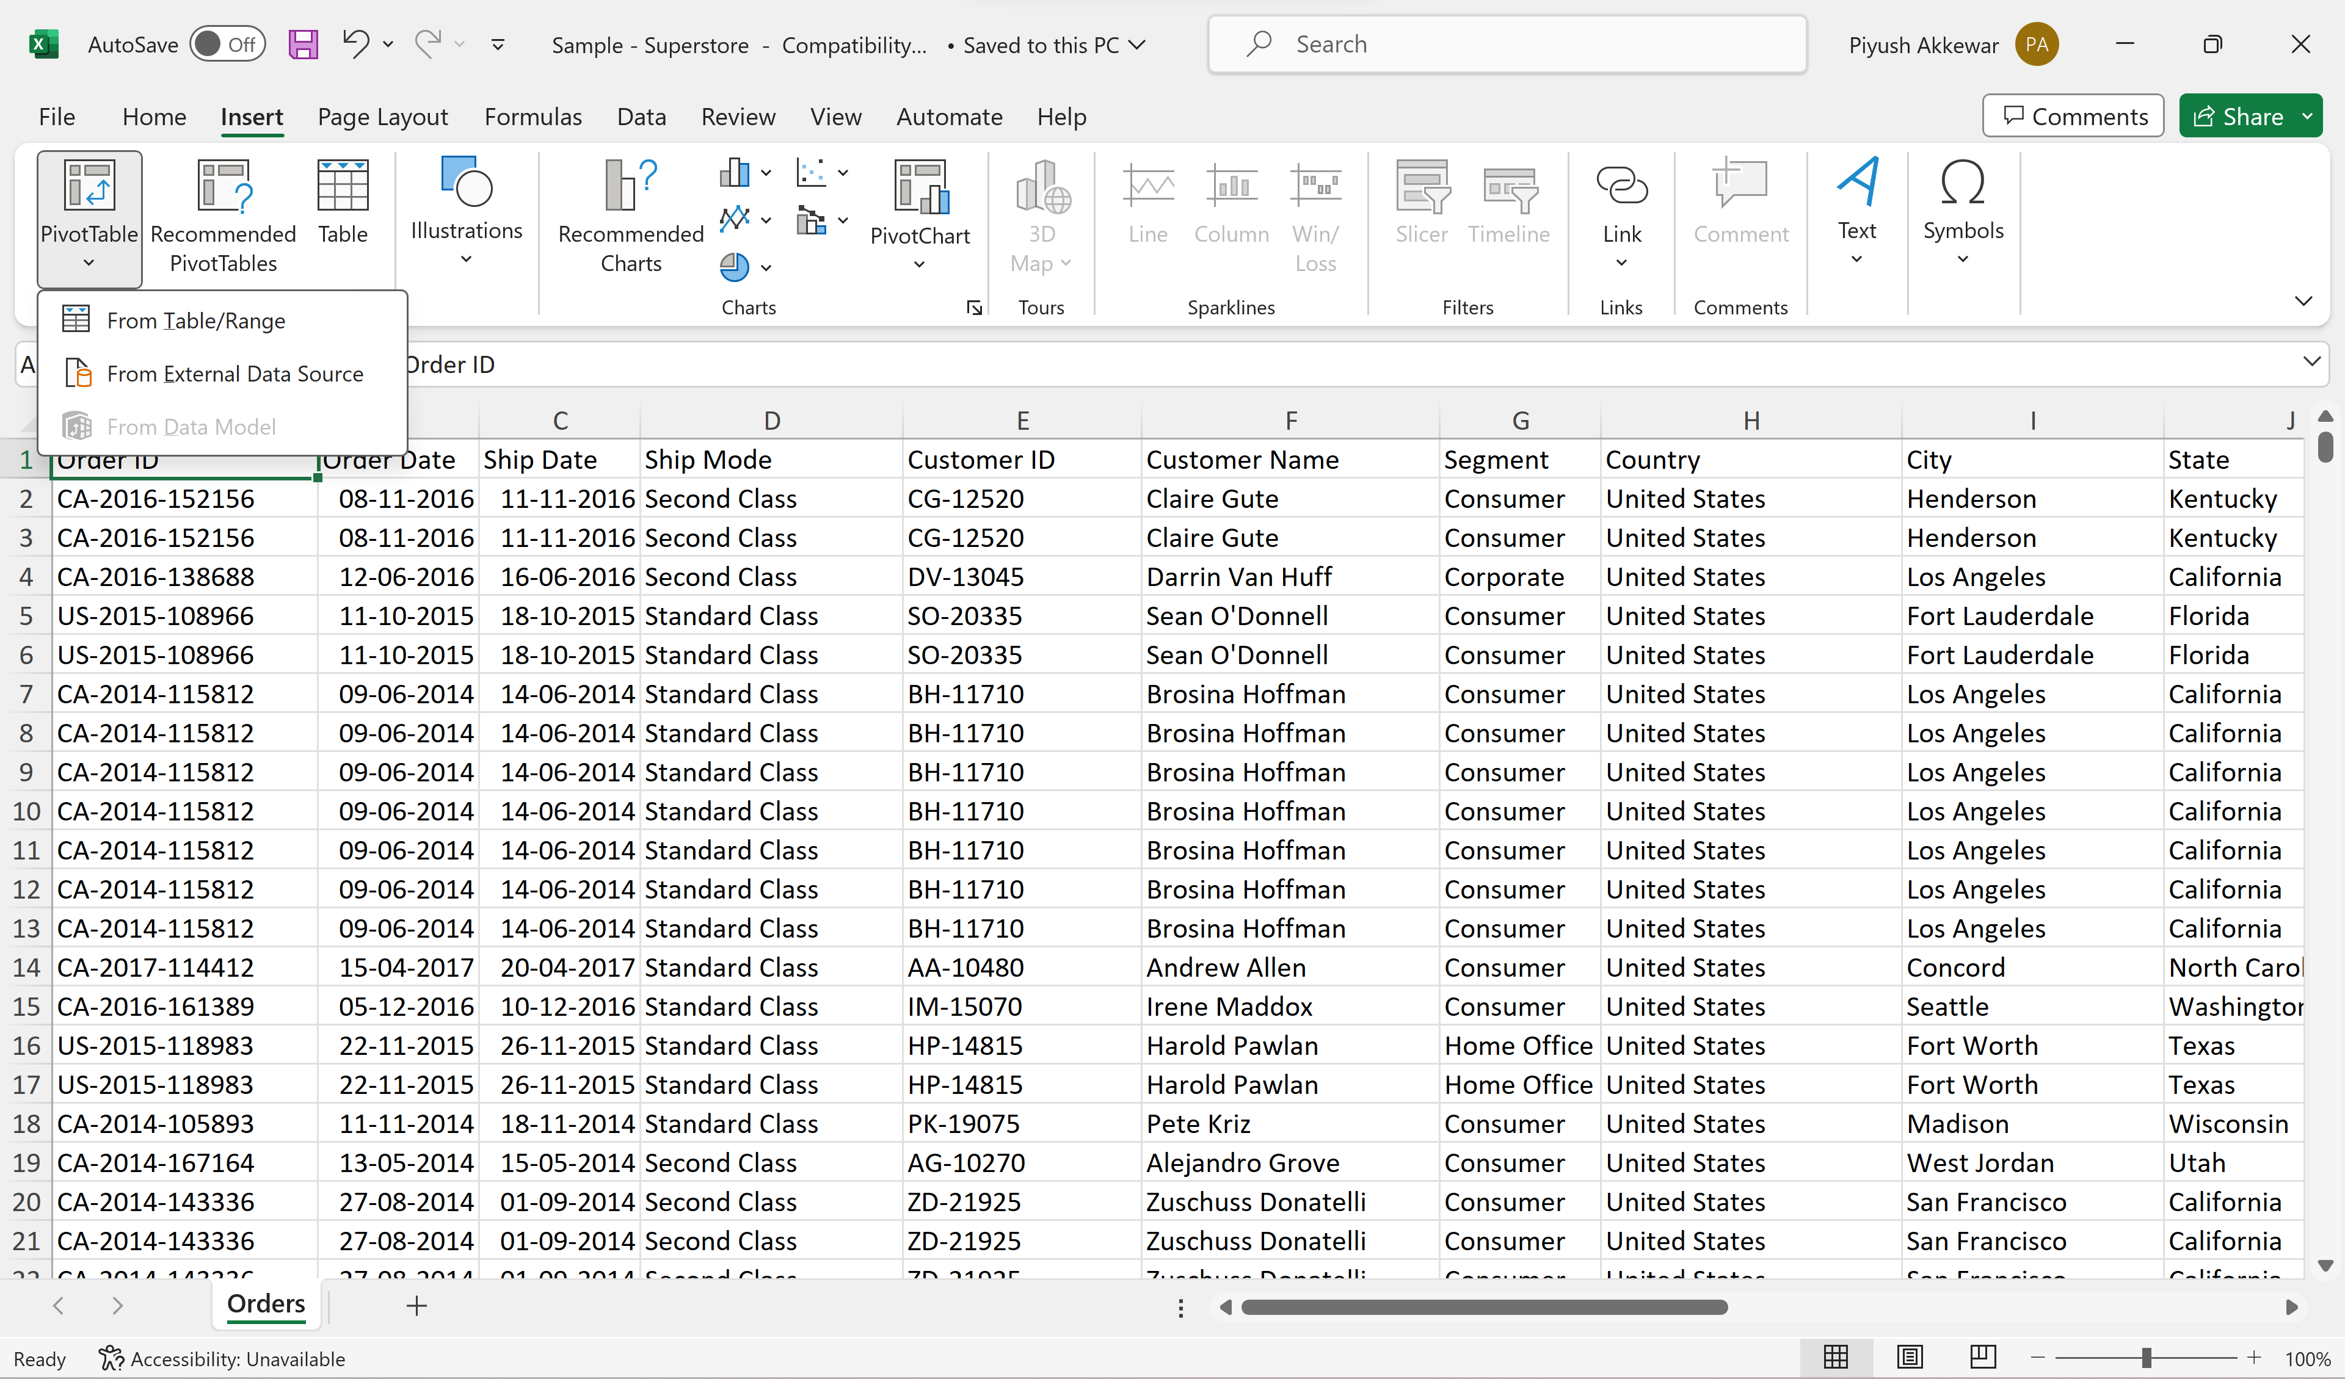
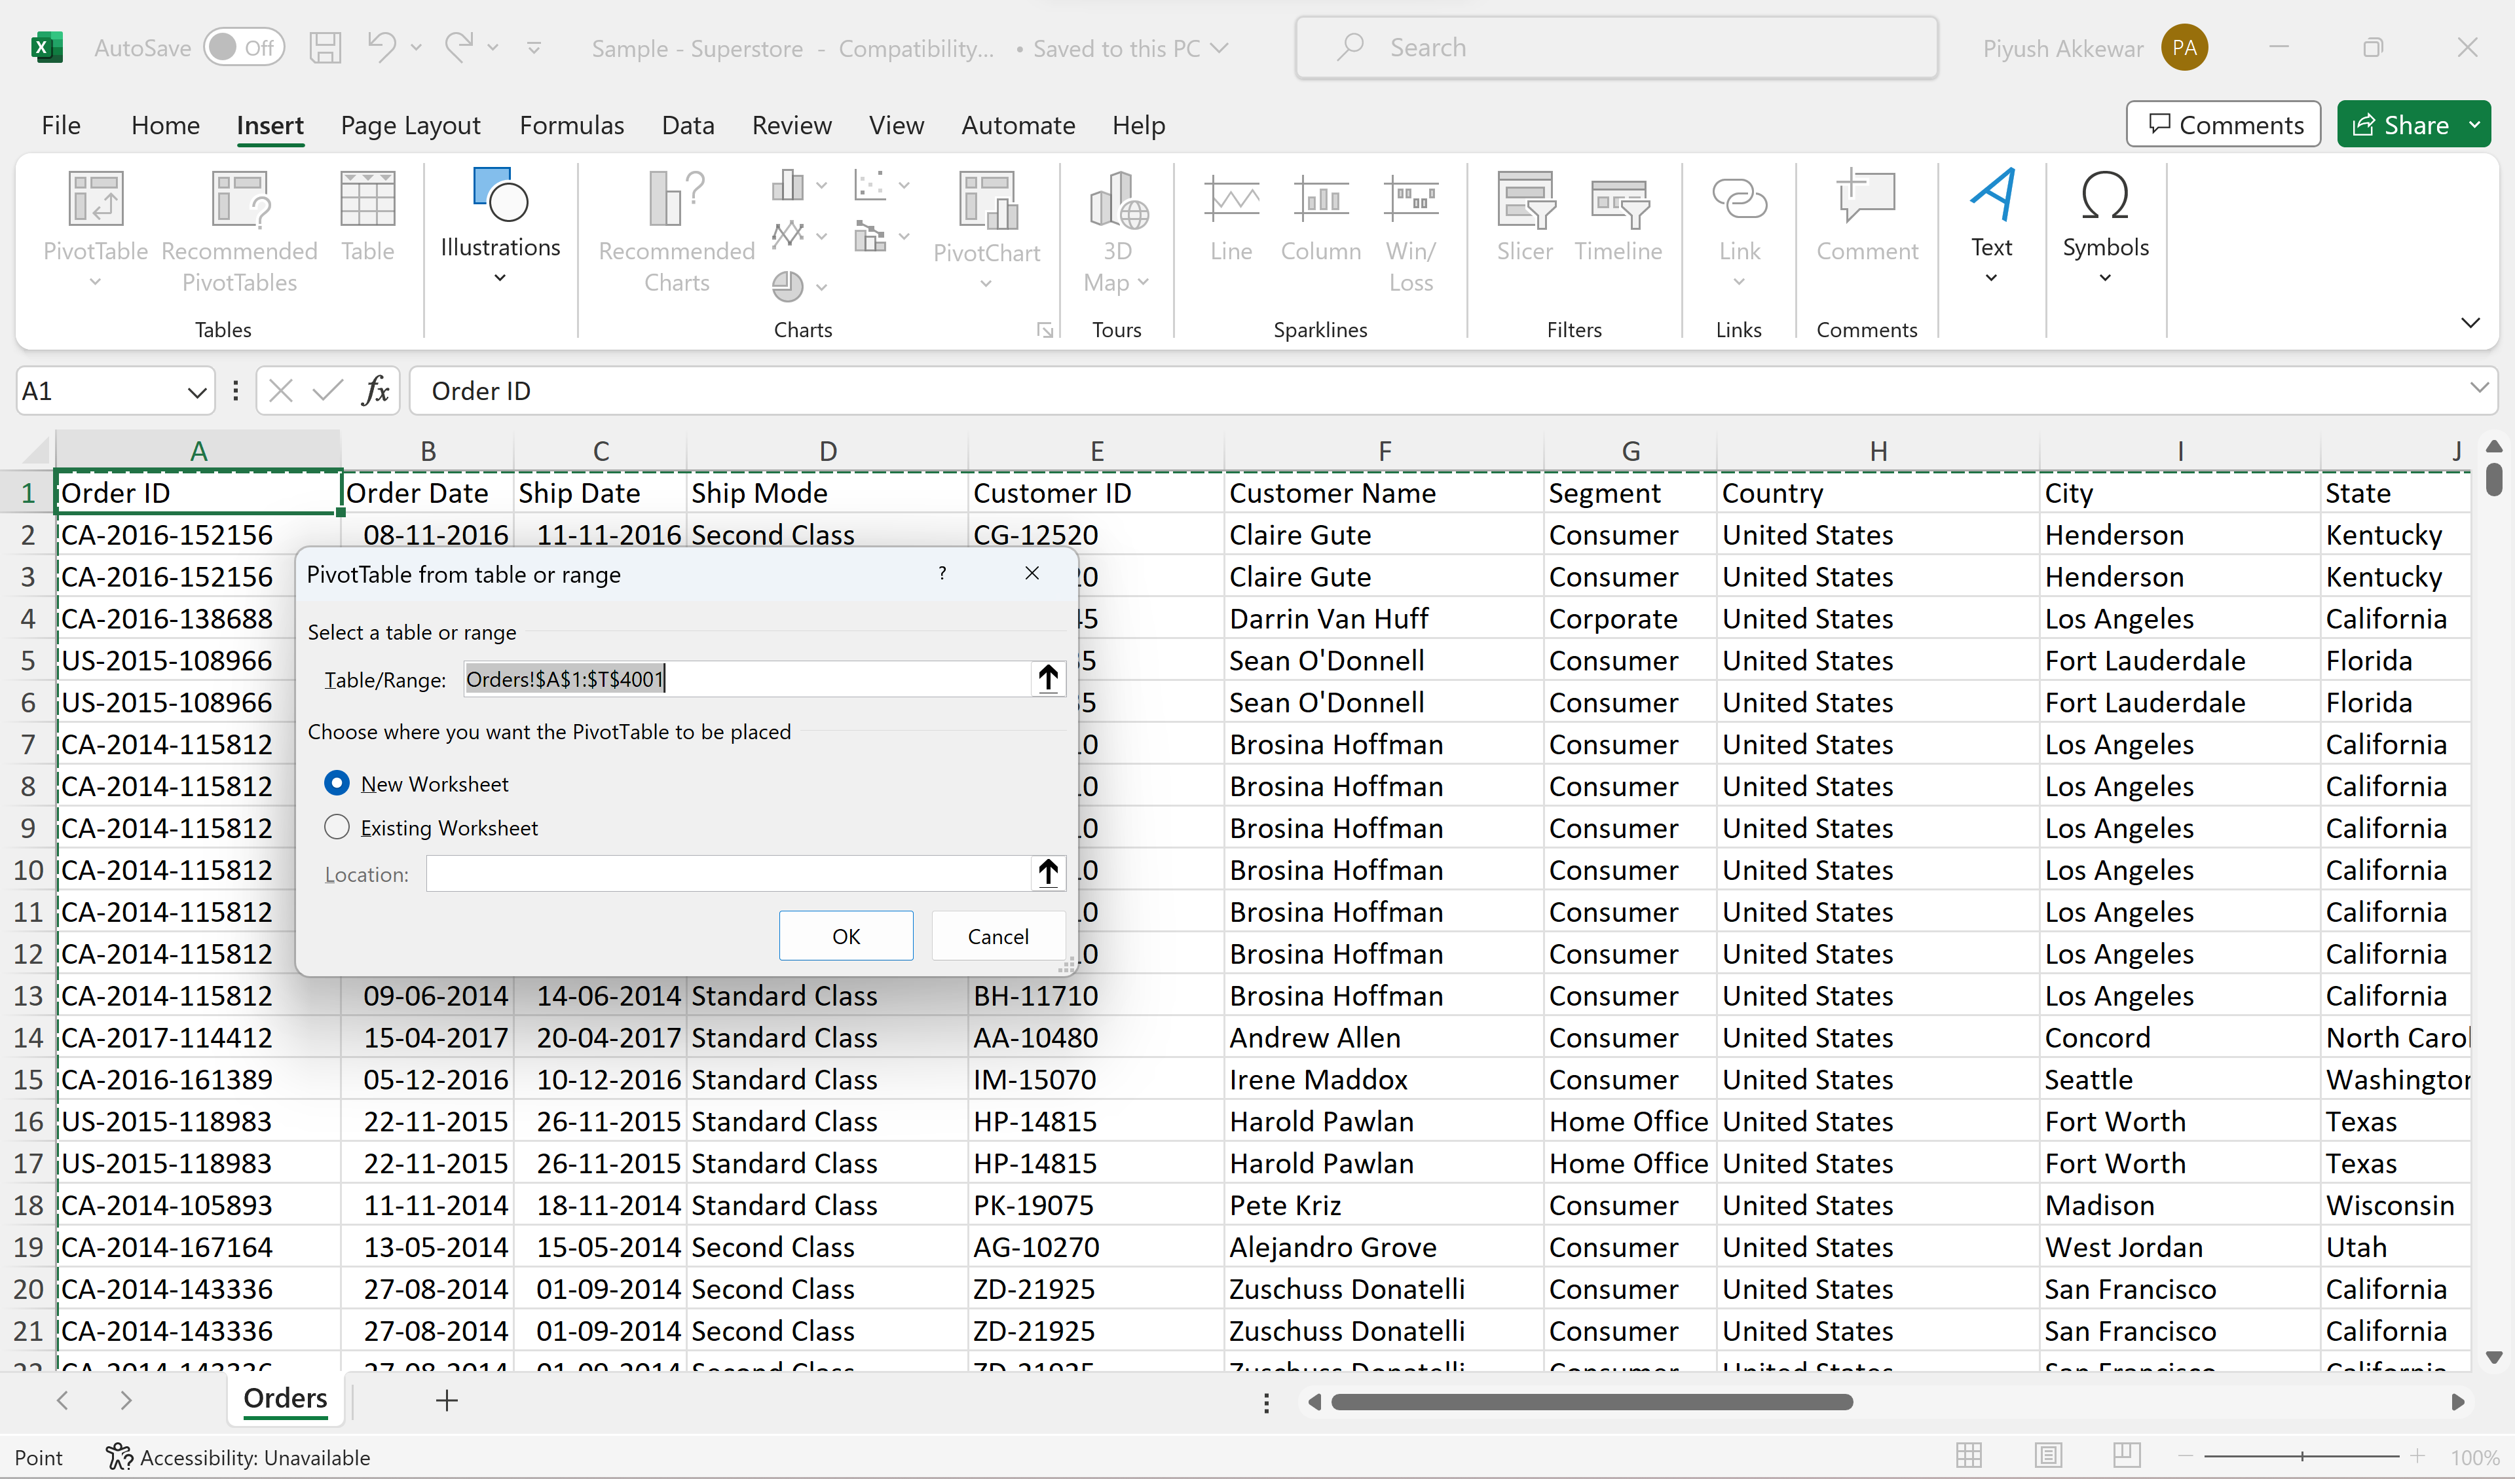
Pivot Tables
Notes:
# Question 1: if statement
number = int(input("Enter a number: "))
if number > 0:
print("The number is positive.")
# Question 2: if-else statement
age = int(input("Enter your age: "))
if age >= 18:
print("You are eligible to vote.")
else:
print("You are not eligible to vote.")
# Question 3: if-elif-else statement
score = int(input("Enter your test score: "))
if score >= 90:
print("Your grade is A.")
elif score >= 80:
print("Your grade is B.")
elif score >= 70:
print("Your grade is C.")
elif score >= 60:
print("Your grade is D.")
else:
print("Your grade is F.")
# Question 4: Nested conditional statements
number = int(input("Enter a number: "))
if number > 0:
if number % 2 == 0:
print("The number is even and positive.")
else:
print("The number is odd and positive.")
elif number < 0:
if number % 2 == 0:
print("The number is even and negative.")
else:
print("The number is odd and negative.")
else:
print("The number is zero.")

Slide 8
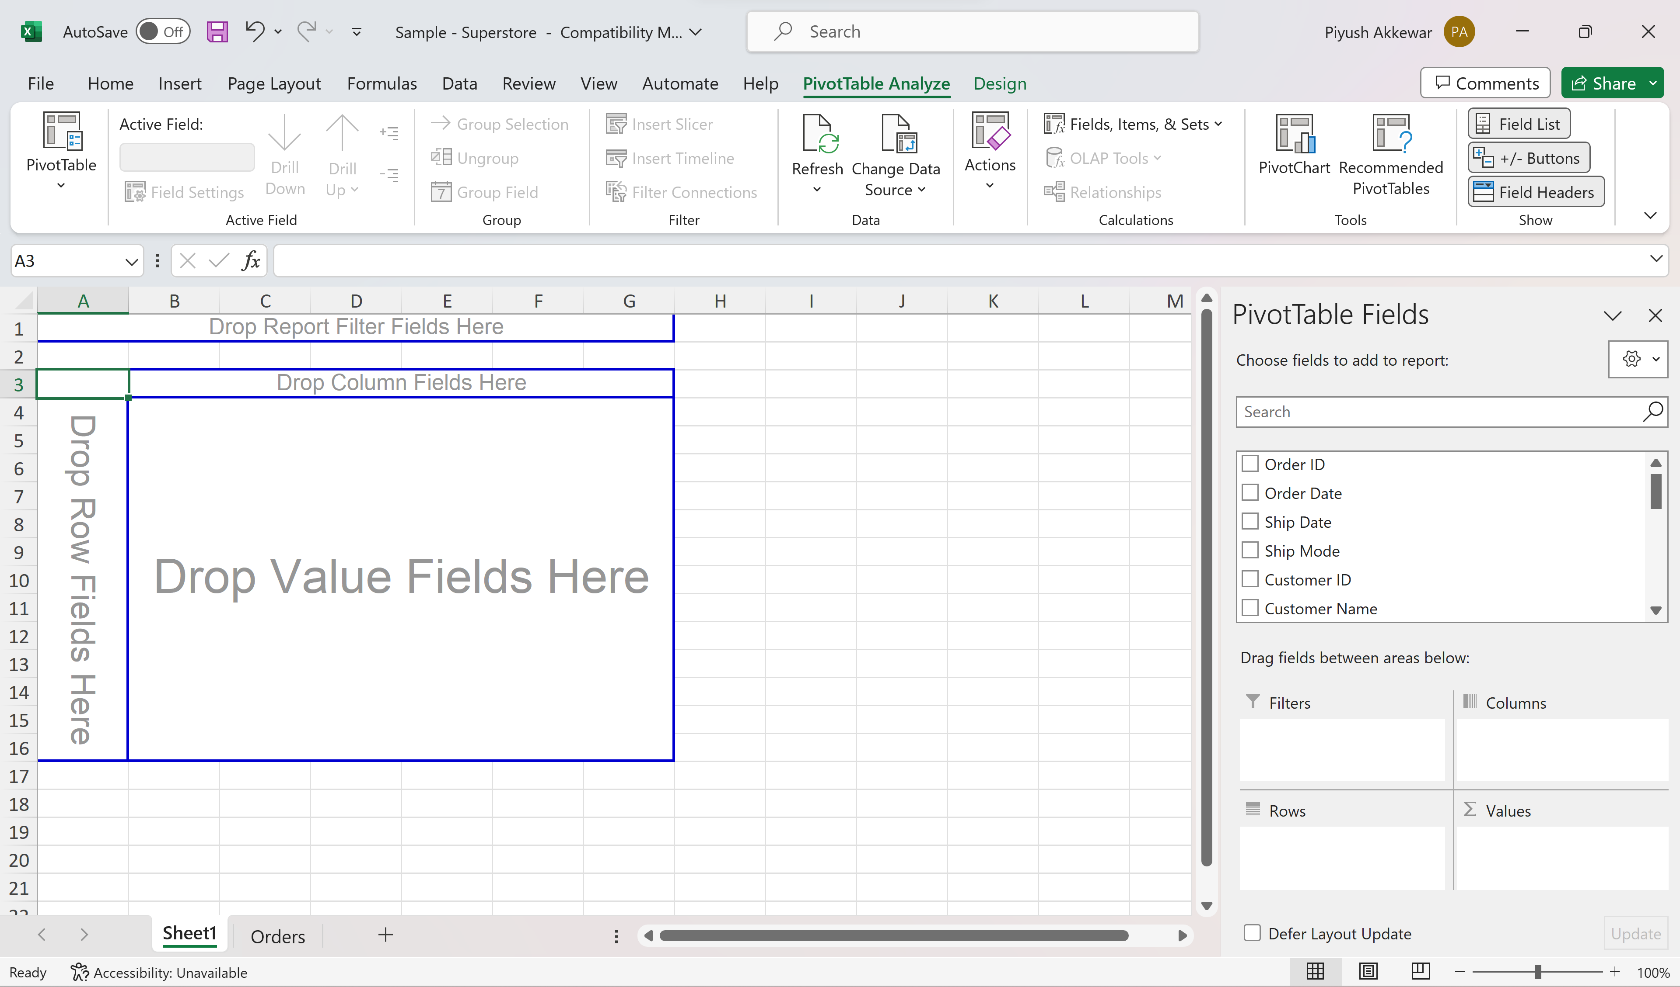
Pivot Tables
Notes:
# Question 1: if statement
number = int(input("Enter a number: "))
if number > 0:
print("The number is positive.")
# Question 2: if-else statement
age = int(input("Enter your age: "))
if age >= 18:
print("You are eligible to vote.")
else:
print("You are not eligible to vote.")
# Question 3: if-elif-else statement
score = int(input("Enter your test score: "))
if score >= 90:
print("Your grade is A.")
elif score >= 80:
print("Your grade is B.")
elif score >= 70:
print("Your grade is C.")
elif score >= 60:
print("Your grade is D.")
else:
print("Your grade is F.")
# Question 4: Nested conditional statements
number = int(input("Enter a number: "))
if number > 0:
if number % 2 == 0:
print("The number is even and positive.")
else:
print("The number is odd and positive.")
elif number < 0:
if number % 2 == 0:
print("The number is even and negative.")
else:
print("The number is odd and negative.")
else:
print("The number is zero.")

Slide 9
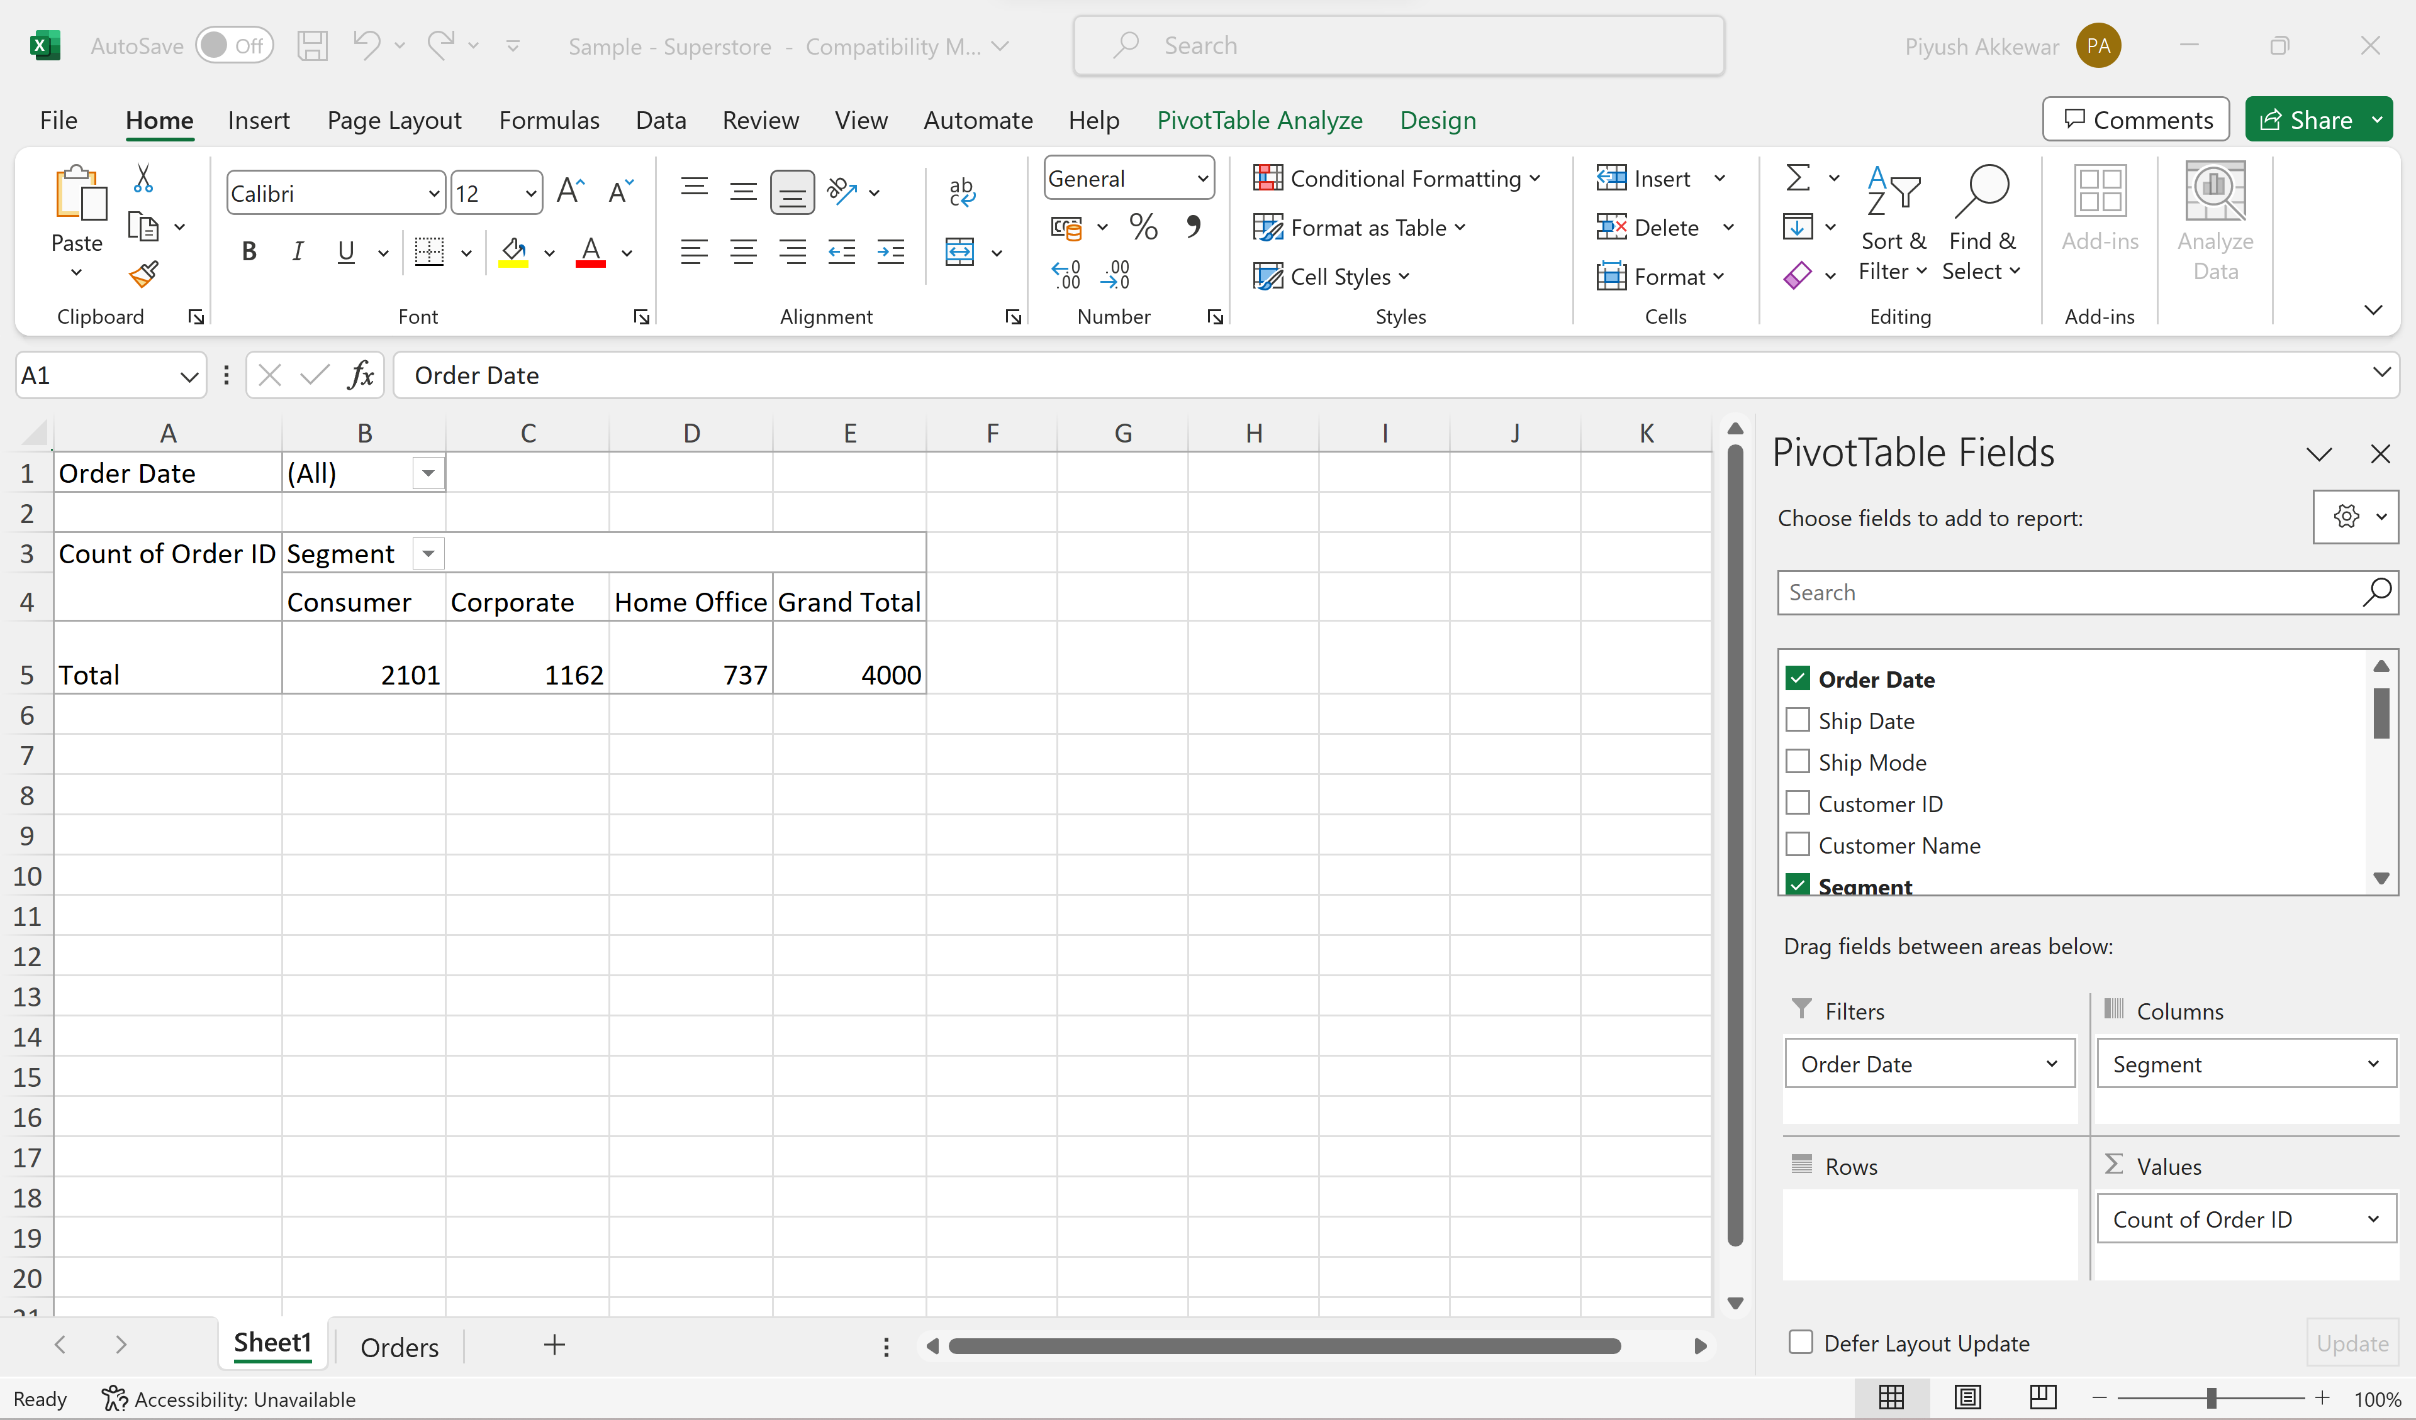
Pivot Tables
Notes:
# Question 1: if statement
number = int(input("Enter a number: "))
if number > 0:
print("The number is positive.")
# Question 2: if-else statement
age = int(input("Enter your age: "))
if age >= 18:
print("You are eligible to vote.")
else:
print("You are not eligible to vote.")
# Question 3: if-elif-else statement
score = int(input("Enter your test score: "))
if score >= 90:
print("Your grade is A.")
elif score >= 80:
print("Your grade is B.")
elif score >= 70:
print("Your grade is C.")
elif score >= 60:
print("Your grade is D.")
else:
print("Your grade is F.")
# Question 4: Nested conditional statements
number = int(input("Enter a number: "))
if number > 0:
if number % 2 == 0:
print("The number is even and positive.")
else:
print("The number is odd and positive.")
elif number < 0:
if number % 2 == 0:
print("The number is even and negative.")
else:
print("The number is odd and negative.")
else:
print("The number is zero.")

Slide 10
Data Analysis in Excel
Identifying Trends and Patterns:
Data analysis in Excel involves recognizing trends and patterns in your dataset.
These trends can be related to time, seasonality, or other factors.
Using IF and VLOOKUP Functions:
IF Function: Apply conditional logic to analyze data based on specific criteria.
VLOOKUP Function: Retrieve data by matching a lookup value to a table.
Conditional Formatting for Insights:
Use conditional formatting to visually highlight data points and detect patterns in your dataset.
Notes:
# Question 1: if statement
number = int(input("Enter a number: "))
if number > 0:
print("The number is positive.")
# Question 2: if-else statement
age = int(input("Enter your age: "))
if age >= 18:
print("You are eligible to vote.")
else:
print("You are not eligible to vote.")
# Question 3: if-elif-else statement
score = int(input("Enter your test score: "))
if score >= 90:
print("Your grade is A.")
elif score >= 80:
print("Your grade is B.")
elif score >= 70:
print("Your grade is C.")
elif score >= 60:
print("Your grade is D.")
else:
print("Your grade is F.")
# Question 4: Nested conditional statements
number = int(input("Enter a number: "))
if number > 0:
if number % 2 == 0:
print("The number is even and positive.")
else:
print("The number is odd and positive.")
elif number < 0:
if number % 2 == 0:
print("The number is even and negative.")
else:
print("The number is odd and negative.")
else:
print("The number is zero.")

Slide 11
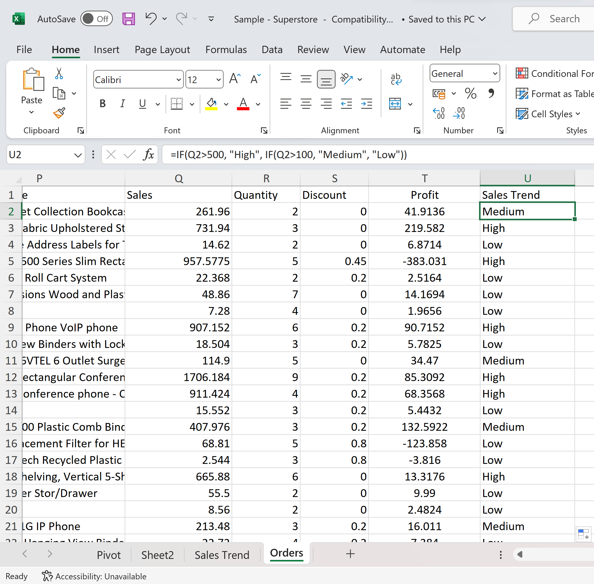
Data Analysis in Excel
If you want to categorize sales into different groups (e.g., "High," "Medium," "Low" sales), you can create a new column and use the IF function.
=IF(Sales > 500, "High", IF(Q2 > 100, "Medium", "Low"))
Once done, a line graph with time can be made to show the sales trends.
Notes:
# Question 1: if statement
number = int(input("Enter a number: "))
if number > 0:
print("The number is positive.")
# Question 2: if-else statement
age = int(input("Enter your age: "))
if age >= 18:
print("You are eligible to vote.")
else:
print("You are not eligible to vote.")
# Question 3: if-elif-else statement
score = int(input("Enter your test score: "))
if score >= 90:
print("Your grade is A.")
elif score >= 80:
print("Your grade is B.")
elif score >= 70:
print("Your grade is C.")
elif score >= 60:
print("Your grade is D.")
else:
print("Your grade is F.")
# Question 4: Nested conditional statements
number = int(input("Enter a number: "))
if number > 0:
if number % 2 == 0:
print("The number is even and positive.")
else:
print("The number is odd and positive.")
elif number < 0:
if number % 2 == 0:
print("The number is even and negative.")
else:
print("The number is odd and negative.")
else:
print("The number is zero.")

Slide 12
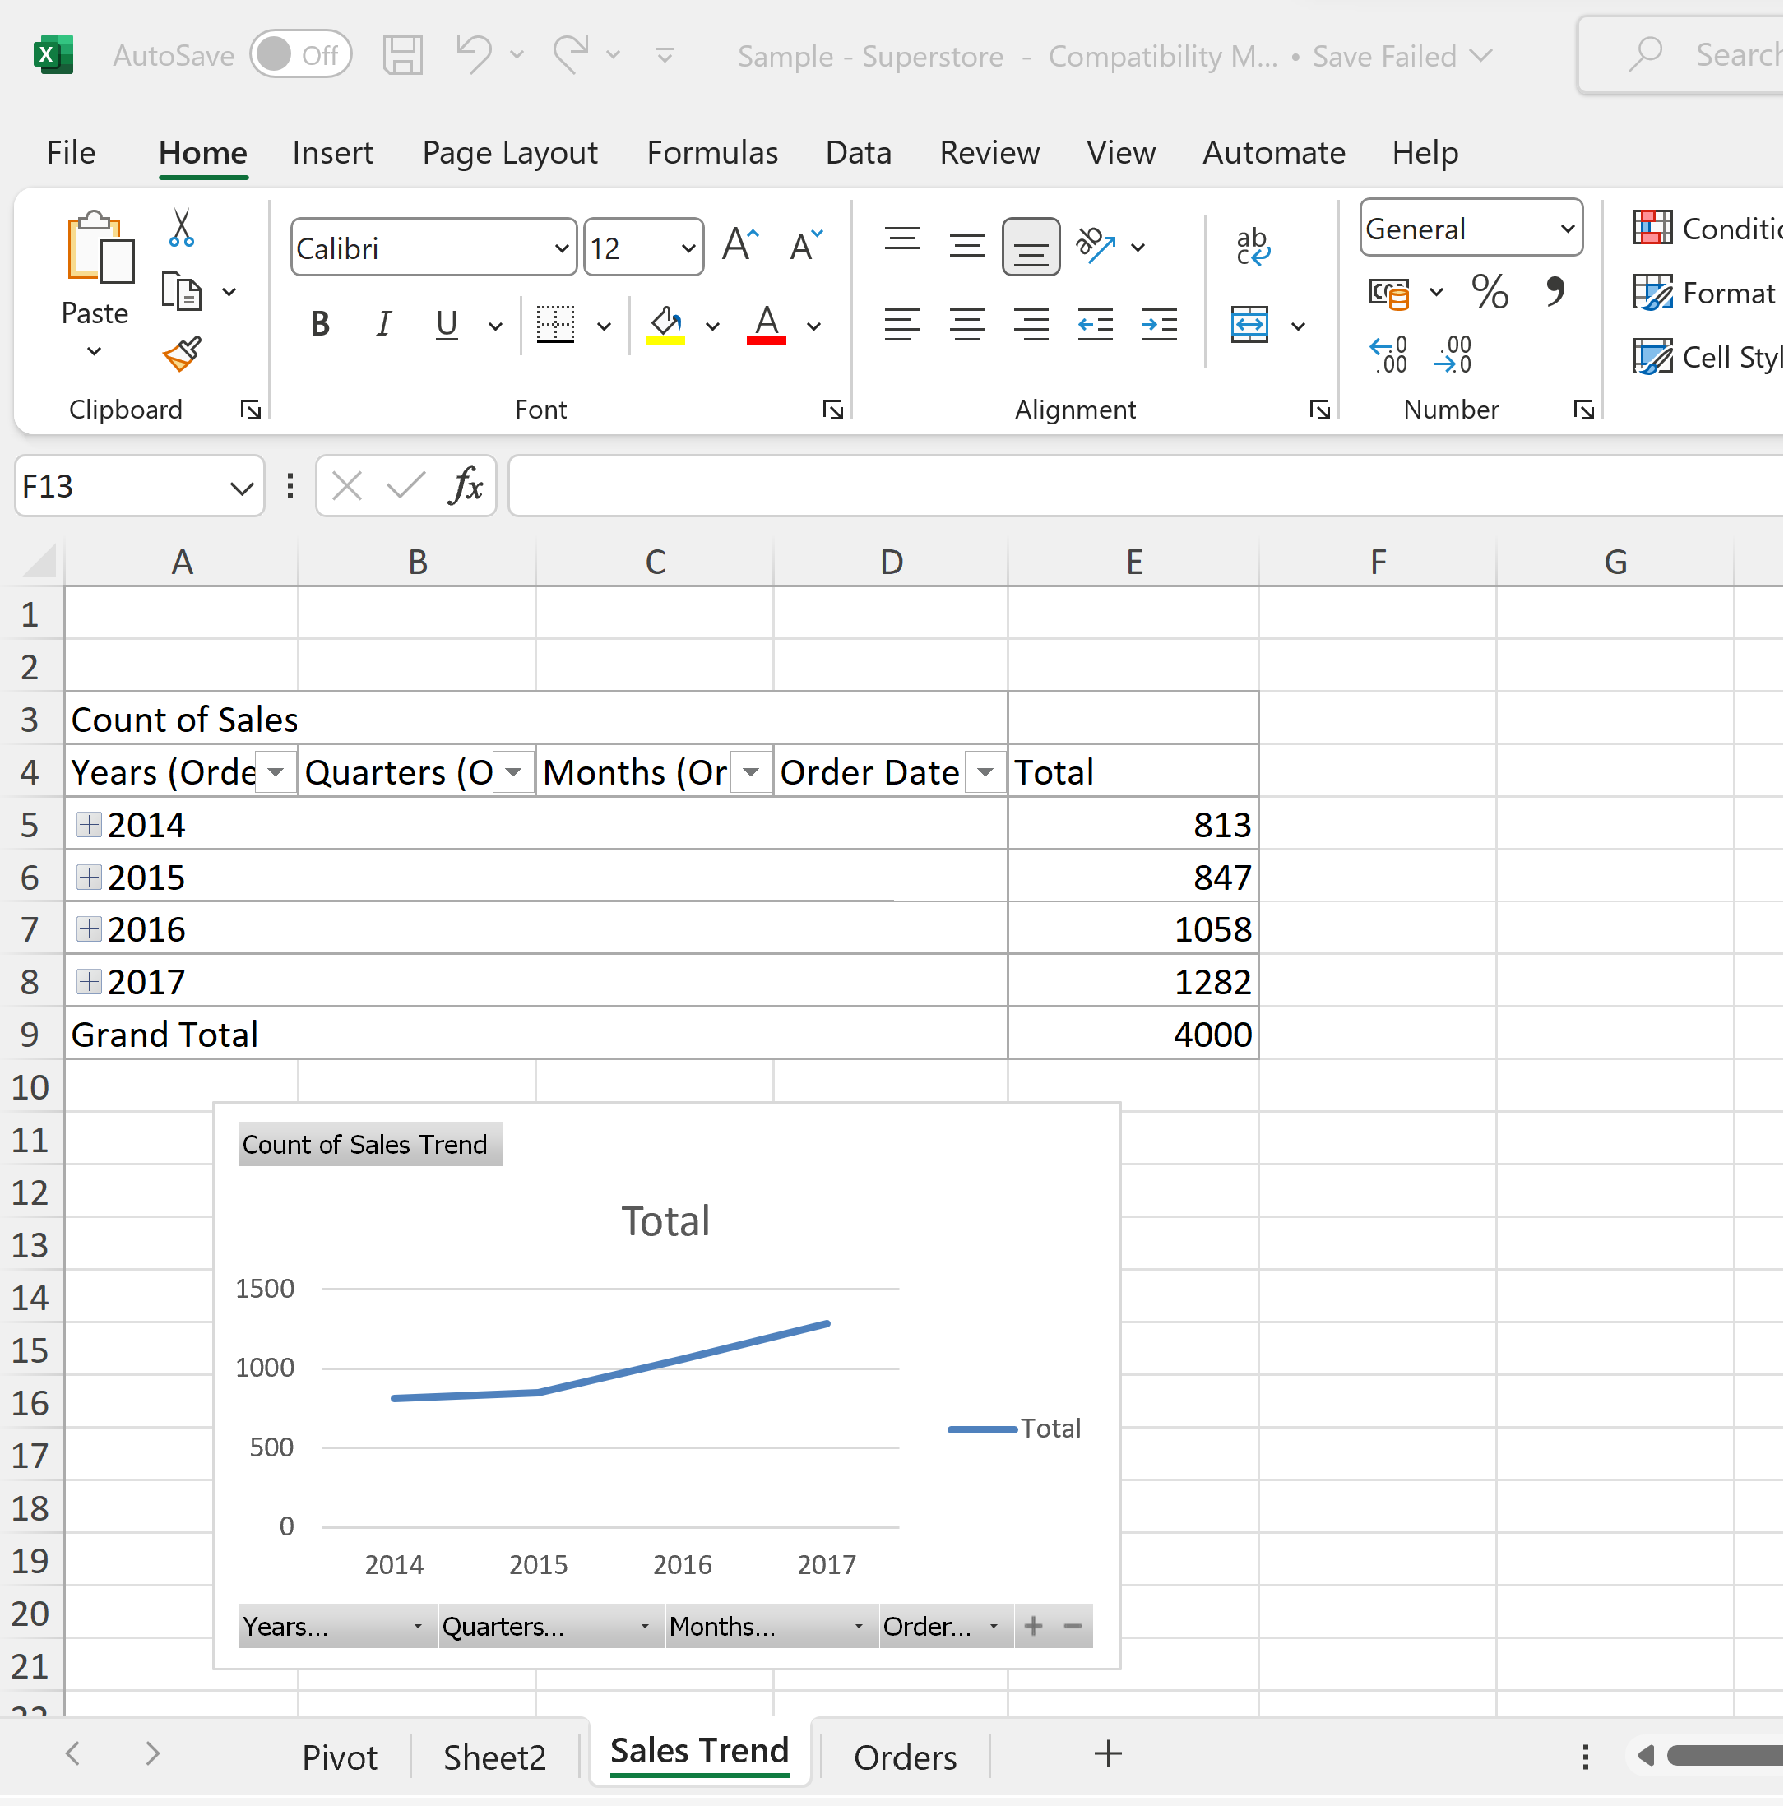
Data Analysis in Excel
Notes:
# Question 1: if statement
number = int(input("Enter a number: "))
if number > 0:
print("The number is positive.")
# Question 2: if-else statement
age = int(input("Enter your age: "))
if age >= 18:
print("You are eligible to vote.")
else:
print("You are not eligible to vote.")
# Question 3: if-elif-else statement
score = int(input("Enter your test score: "))
if score >= 90:
print("Your grade is A.")
elif score >= 80:
print("Your grade is B.")
elif score >= 70:
print("Your grade is C.")
elif score >= 60:
print("Your grade is D.")
else:
print("Your grade is F.")
# Question 4: Nested conditional statements
number = int(input("Enter a number: "))
if number > 0:
if number % 2 == 0:
print("The number is even and positive.")
else:
print("The number is odd and positive.")
elif number < 0:
if number % 2 == 0:
print("The number is even and negative.")
else:
print("The number is odd and negative.")
else:
print("The number is zero.")

Slide 13
Data Visualization in Excel
Excel offers various chart types (e.g., column, line, pie) for visualizing data.
Create charts by selecting data, navigating to the "Insert" tab, and choosing a chart type.
Customize charts with formatting, colors, titles, and fonts.
Add data labels and legends for clarity.
Visualizations reveal trends, patterns, and anomalies in data.
Interactive features, pivot tables, and conditional formatting enhance data analysis.
Excel's charts help transform raw data into meaningful insights for informed decision-making.
Notes:
# Question 1: if statement
number = int(input("Enter a number: "))
if number > 0:
print("The number is positive.")
# Question 2: if-else statement
age = int(input("Enter your age: "))
if age >= 18:
print("You are eligible to vote.")
else:
print("You are not eligible to vote.")
# Question 3: if-elif-else statement
score = int(input("Enter your test score: "))
if score >= 90:
print("Your grade is A.")
elif score >= 80:
print("Your grade is B.")
elif score >= 70:
print("Your grade is C.")
elif score >= 60:
print("Your grade is D.")
else:
print("Your grade is F.")
# Question 4: Nested conditional statements
number = int(input("Enter a number: "))
if number > 0:
if number % 2 == 0:
print("The number is even and positive.")
else:
print("The number is odd and positive.")
elif number < 0:
if number % 2 == 0:
print("The number is even and negative.")
else:
print("The number is odd and negative.")
else:
print("The number is zero.")

Slide 14
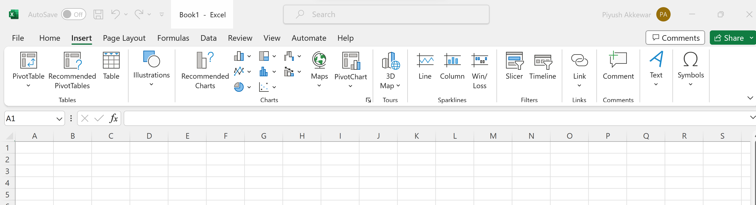
Data Visualization in Excel
Notes:
# Question 1: if statement
number = int(input("Enter a number: "))
if number > 0:
print("The number is positive.")
# Question 2: if-else statement
age = int(input("Enter your age: "))
if age >= 18:
print("You are eligible to vote.")
else:
print("You are not eligible to vote.")
# Question 3: if-elif-else statement
score = int(input("Enter your test score: "))
if score >= 90:
print("Your grade is A.")
elif score >= 80:
print("Your grade is B.")
elif score >= 70:
print("Your grade is C.")
elif score >= 60:
print("Your grade is D.")
else:
print("Your grade is F.")
# Question 4: Nested conditional statements
number = int(input("Enter a number: "))
if number > 0:
if number % 2 == 0:
print("The number is even and positive.")
else:
print("The number is odd and positive.")
elif number < 0:
if number % 2 == 0:
print("The number is even and negative.")
else:
print("The number is odd and negative.")
else:
print("The number is zero.")

Slide 15
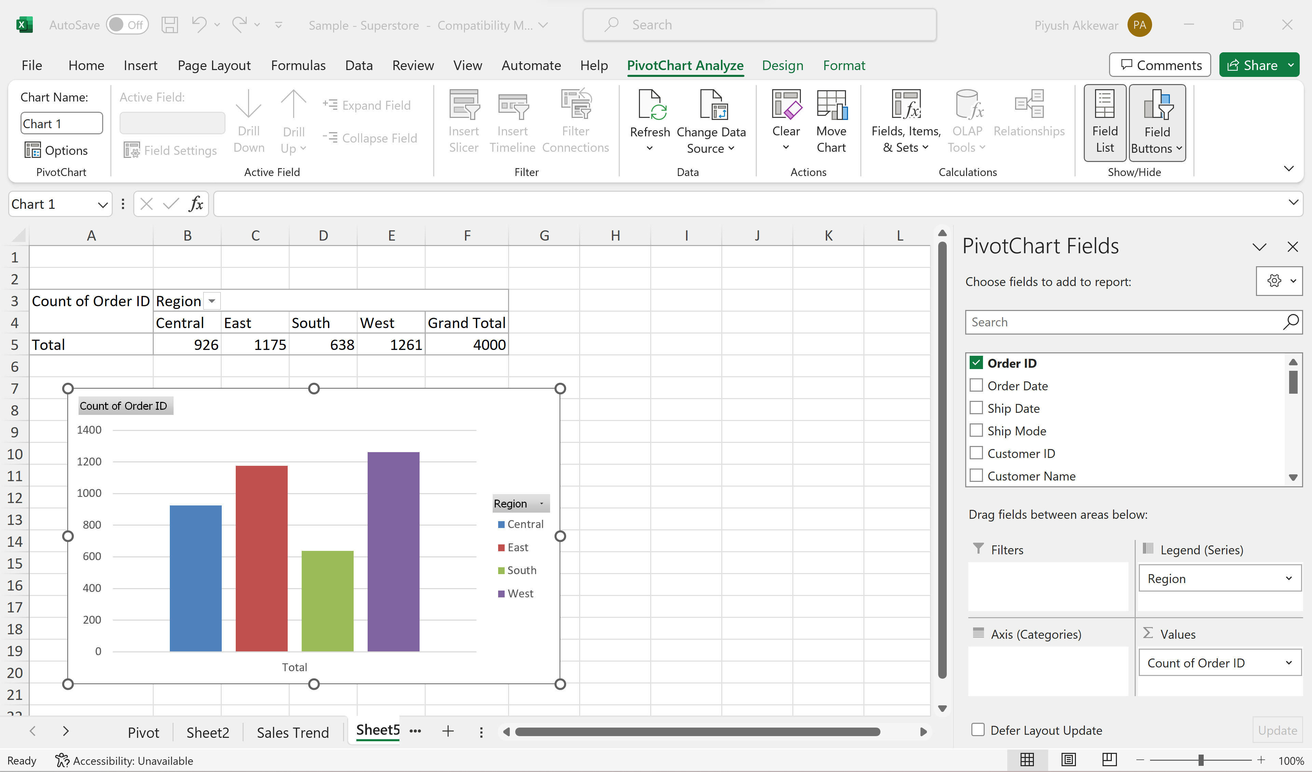
Data Visualization in Excel
Column Charts:
Select your data and go to the "Insert" tab in Excel.
Choose "Column Chart" and select the appropriate subtype (e.g., clustered or stacked).
Notes:
# Question 1: if statement
number = int(input("Enter a number: "))
if number > 0:
print("The number is positive.")
# Question 2: if-else statement
age = int(input("Enter your age: "))
if age >= 18:
print("You are eligible to vote.")
else:
print("You are not eligible to vote.")
# Question 3: if-elif-else statement
score = int(input("Enter your test score: "))
if score >= 90:
print("Your grade is A.")
elif score >= 80:
print("Your grade is B.")
elif score >= 70:
print("Your grade is C.")
elif score >= 60:
print("Your grade is D.")
else:
print("Your grade is F.")
# Question 4: Nested conditional statements
number = int(input("Enter a number: "))
if number > 0:
if number % 2 == 0:
print("The number is even and positive.")
else:
print("The number is odd and positive.")
elif number < 0:
if number % 2 == 0:
print("The number is even and negative.")
else:
print("The number is odd and negative.")
else:
print("The number is zero.")

Slide 16
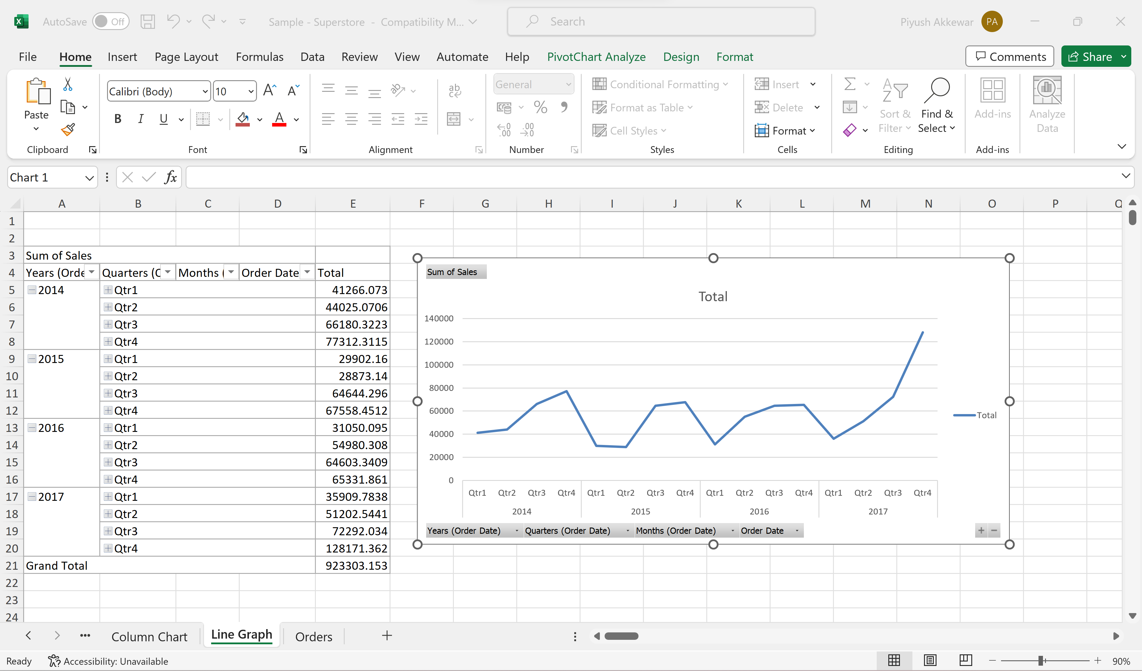
Data Visualization in Excel
Line Charts:
Line charts are ideal for visualizing trends over continuous data.
Create one by selecting your data and choosing "Line Chart" from the "Insert" tab in Excel.
Notes:
# Question 1: if statement
number = int(input("Enter a number: "))
if number > 0:
print("The number is positive.")
# Question 2: if-else statement
age = int(input("Enter your age: "))
if age >= 18:
print("You are eligible to vote.")
else:
print("You are not eligible to vote.")
# Question 3: if-elif-else statement
score = int(input("Enter your test score: "))
if score >= 90:
print("Your grade is A.")
elif score >= 80:
print("Your grade is B.")
elif score >= 70:
print("Your grade is C.")
elif score >= 60:
print("Your grade is D.")
else:
print("Your grade is F.")
# Question 4: Nested conditional statements
number = int(input("Enter a number: "))
if number > 0:
if number % 2 == 0:
print("The number is even and positive.")
else:
print("The number is odd and positive.")
elif number < 0:
if number % 2 == 0:
print("The number is even and negative.")
else:
print("The number is odd and negative.")
else:
print("The number is zero.")

Slide 17
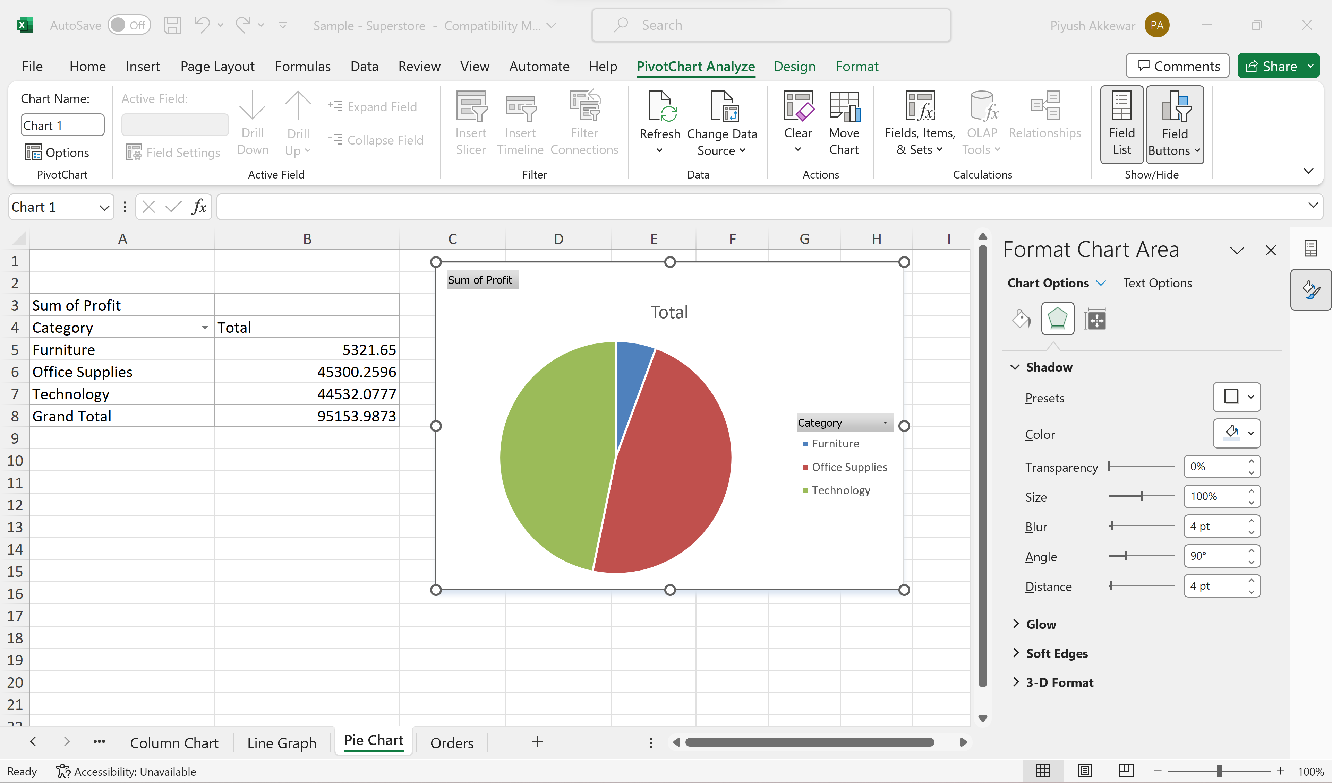
Data Visualization in Excel
Pie Charts:
In Excel, select data and insert a pie chart.
Customize colors, labels, and explosion for clarity.
Notes:
# Question 1: if statement
number = int(input("Enter a number: "))
if number > 0:
print("The number is positive.")
# Question 2: if-else statement
age = int(input("Enter your age: "))
if age >= 18:
print("You are eligible to vote.")
else:
print("You are not eligible to vote.")
# Question 3: if-elif-else statement
score = int(input("Enter your test score: "))
if score >= 90:
print("Your grade is A.")
elif score >= 80:
print("Your grade is B.")
elif score >= 70:
print("Your grade is C.")
elif score >= 60:
print("Your grade is D.")
else:
print("Your grade is F.")
# Question 4: Nested conditional statements
number = int(input("Enter a number: "))
if number > 0:
if number % 2 == 0:
print("The number is even and positive.")
else:
print("The number is odd and positive.")
elif number < 0:
if number % 2 == 0:
print("The number is even and negative.")
else:
print("The number is odd and negative.")
else:
print("The number is zero.")

Slide 18
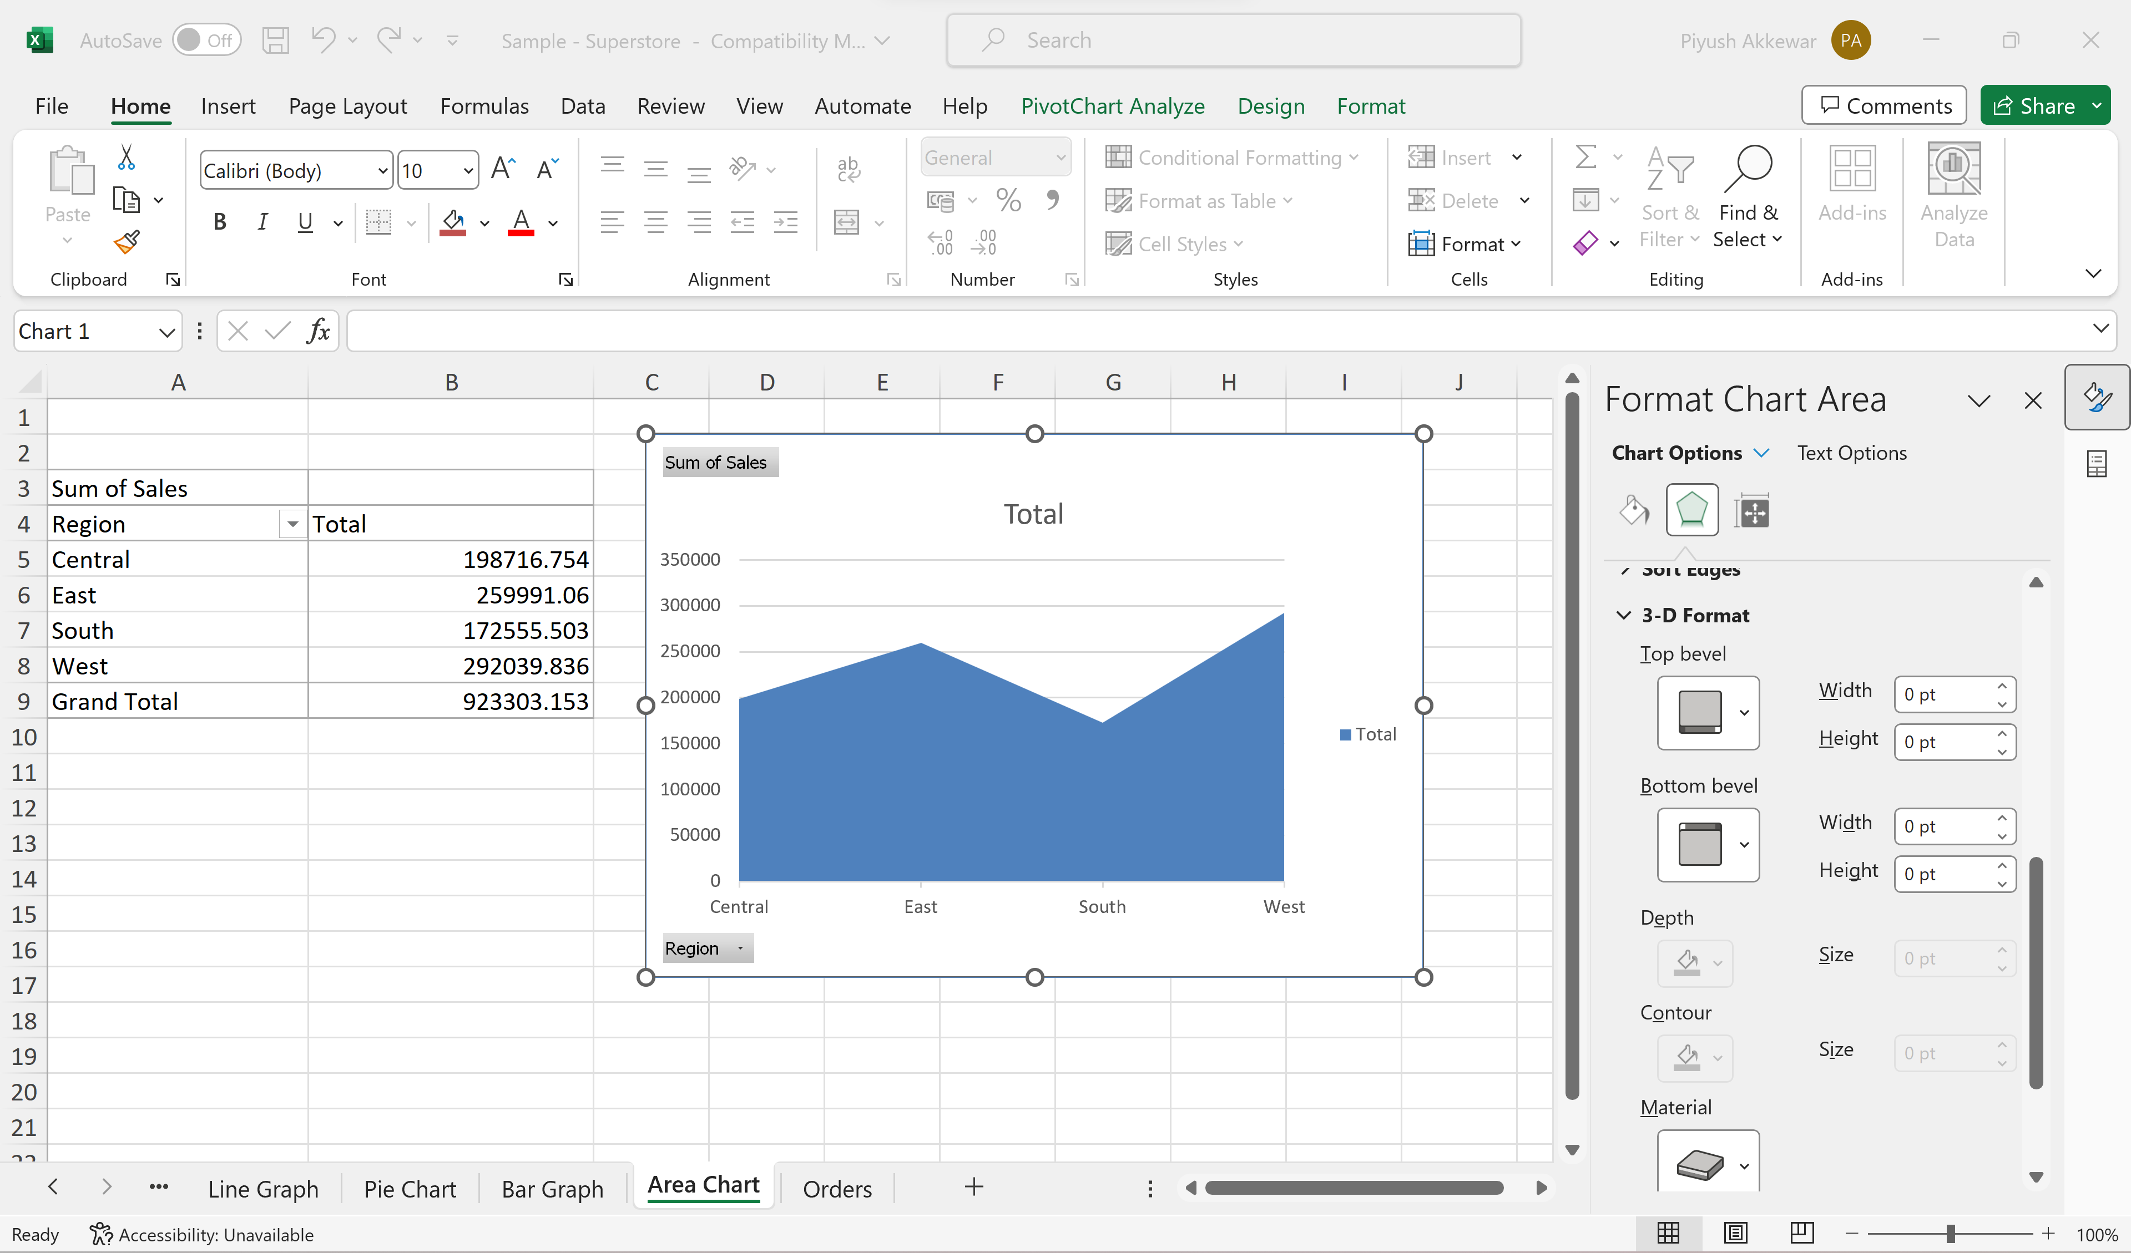
Data Visualization in Excel
Area Charts:
In Excel, select data and insert an area chart.
Depict data with filled areas below lines.
Useful for showing trends over time.
Notes:
# Question 1: if statement
number = int(input("Enter a number: "))
if number > 0:
print("The number is positive.")
# Question 2: if-else statement
age = int(input("Enter your age: "))
if age >= 18:
print("You are eligible to vote.")
else:
print("You are not eligible to vote.")
# Question 3: if-elif-else statement
score = int(input("Enter your test score: "))
if score >= 90:
print("Your grade is A.")
elif score >= 80:
print("Your grade is B.")
elif score >= 70:
print("Your grade is C.")
elif score >= 60:
print("Your grade is D.")
else:
print("Your grade is F.")
# Question 4: Nested conditional statements
number = int(input("Enter a number: "))
if number > 0:
if number % 2 == 0:
print("The number is even and positive.")
else:
print("The number is odd and positive.")
elif number < 0:
if number % 2 == 0:
print("The number is even and negative.")
else:
print("The number is odd and negative.")
else:
print("The number is zero.")

Slide 19
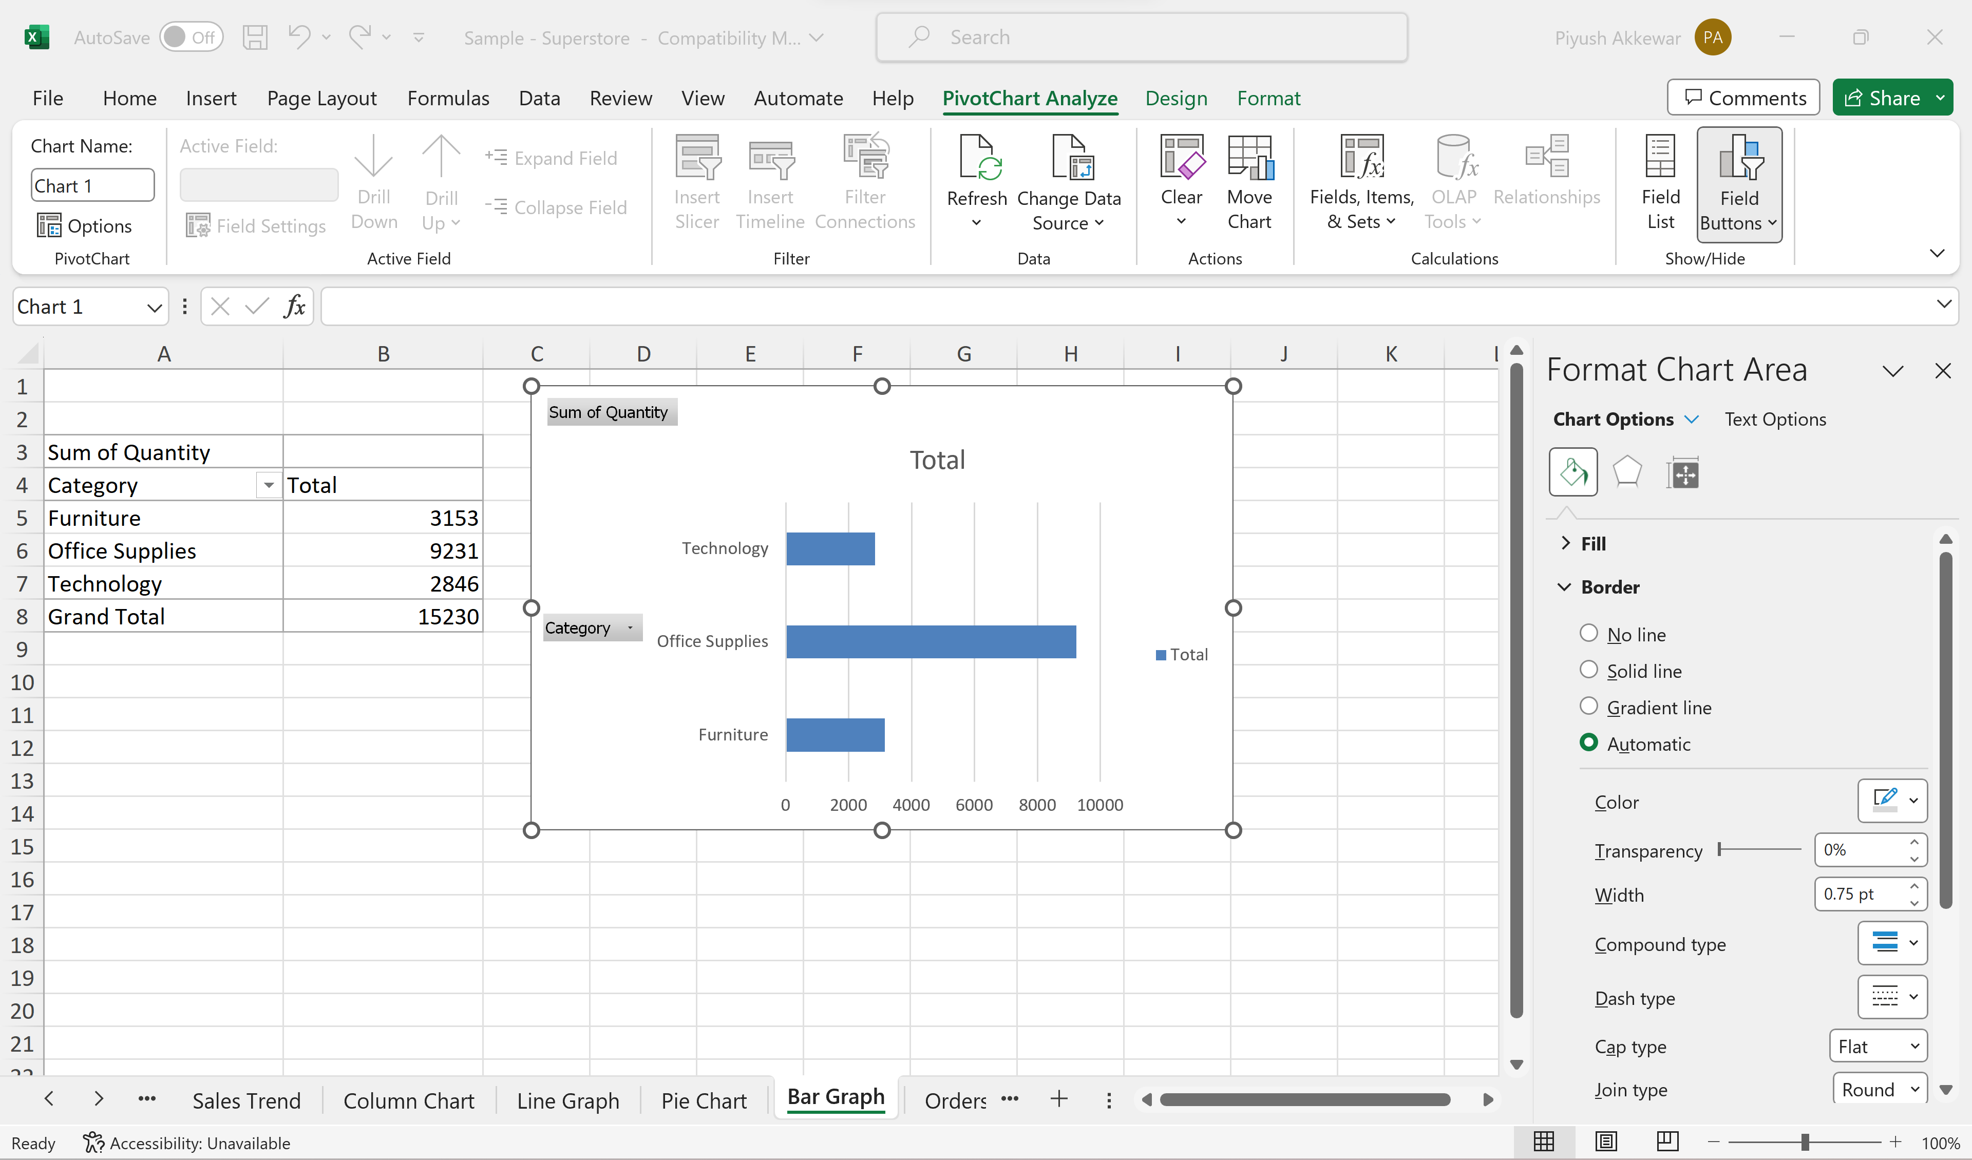
Data Visualization in Excel
Bar Charts:
In Excel, select data and insert a bar chart.
Choose from different styles and layouts.
Notes:
# Question 1: if statement
number = int(input("Enter a number: "))
if number > 0:
print("The number is positive.")
# Question 2: if-else statement
age = int(input("Enter your age: "))
if age >= 18:
print("You are eligible to vote.")
else:
print("You are not eligible to vote.")
# Question 3: if-elif-else statement
score = int(input("Enter your test score: "))
if score >= 90:
print("Your grade is A.")
elif score >= 80:
print("Your grade is B.")
elif score >= 70:
print("Your grade is C.")
elif score >= 60:
print("Your grade is D.")
else:
print("Your grade is F.")
# Question 4: Nested conditional statements
number = int(input("Enter a number: "))
if number > 0:
if number % 2 == 0:
print("The number is even and positive.")
else:
print("The number is odd and positive.")
elif number < 0:
if number % 2 == 0:
print("The number is even and negative.")
else:
print("The number is odd and negative.")
else:
print("The number is zero.")

Slide 20
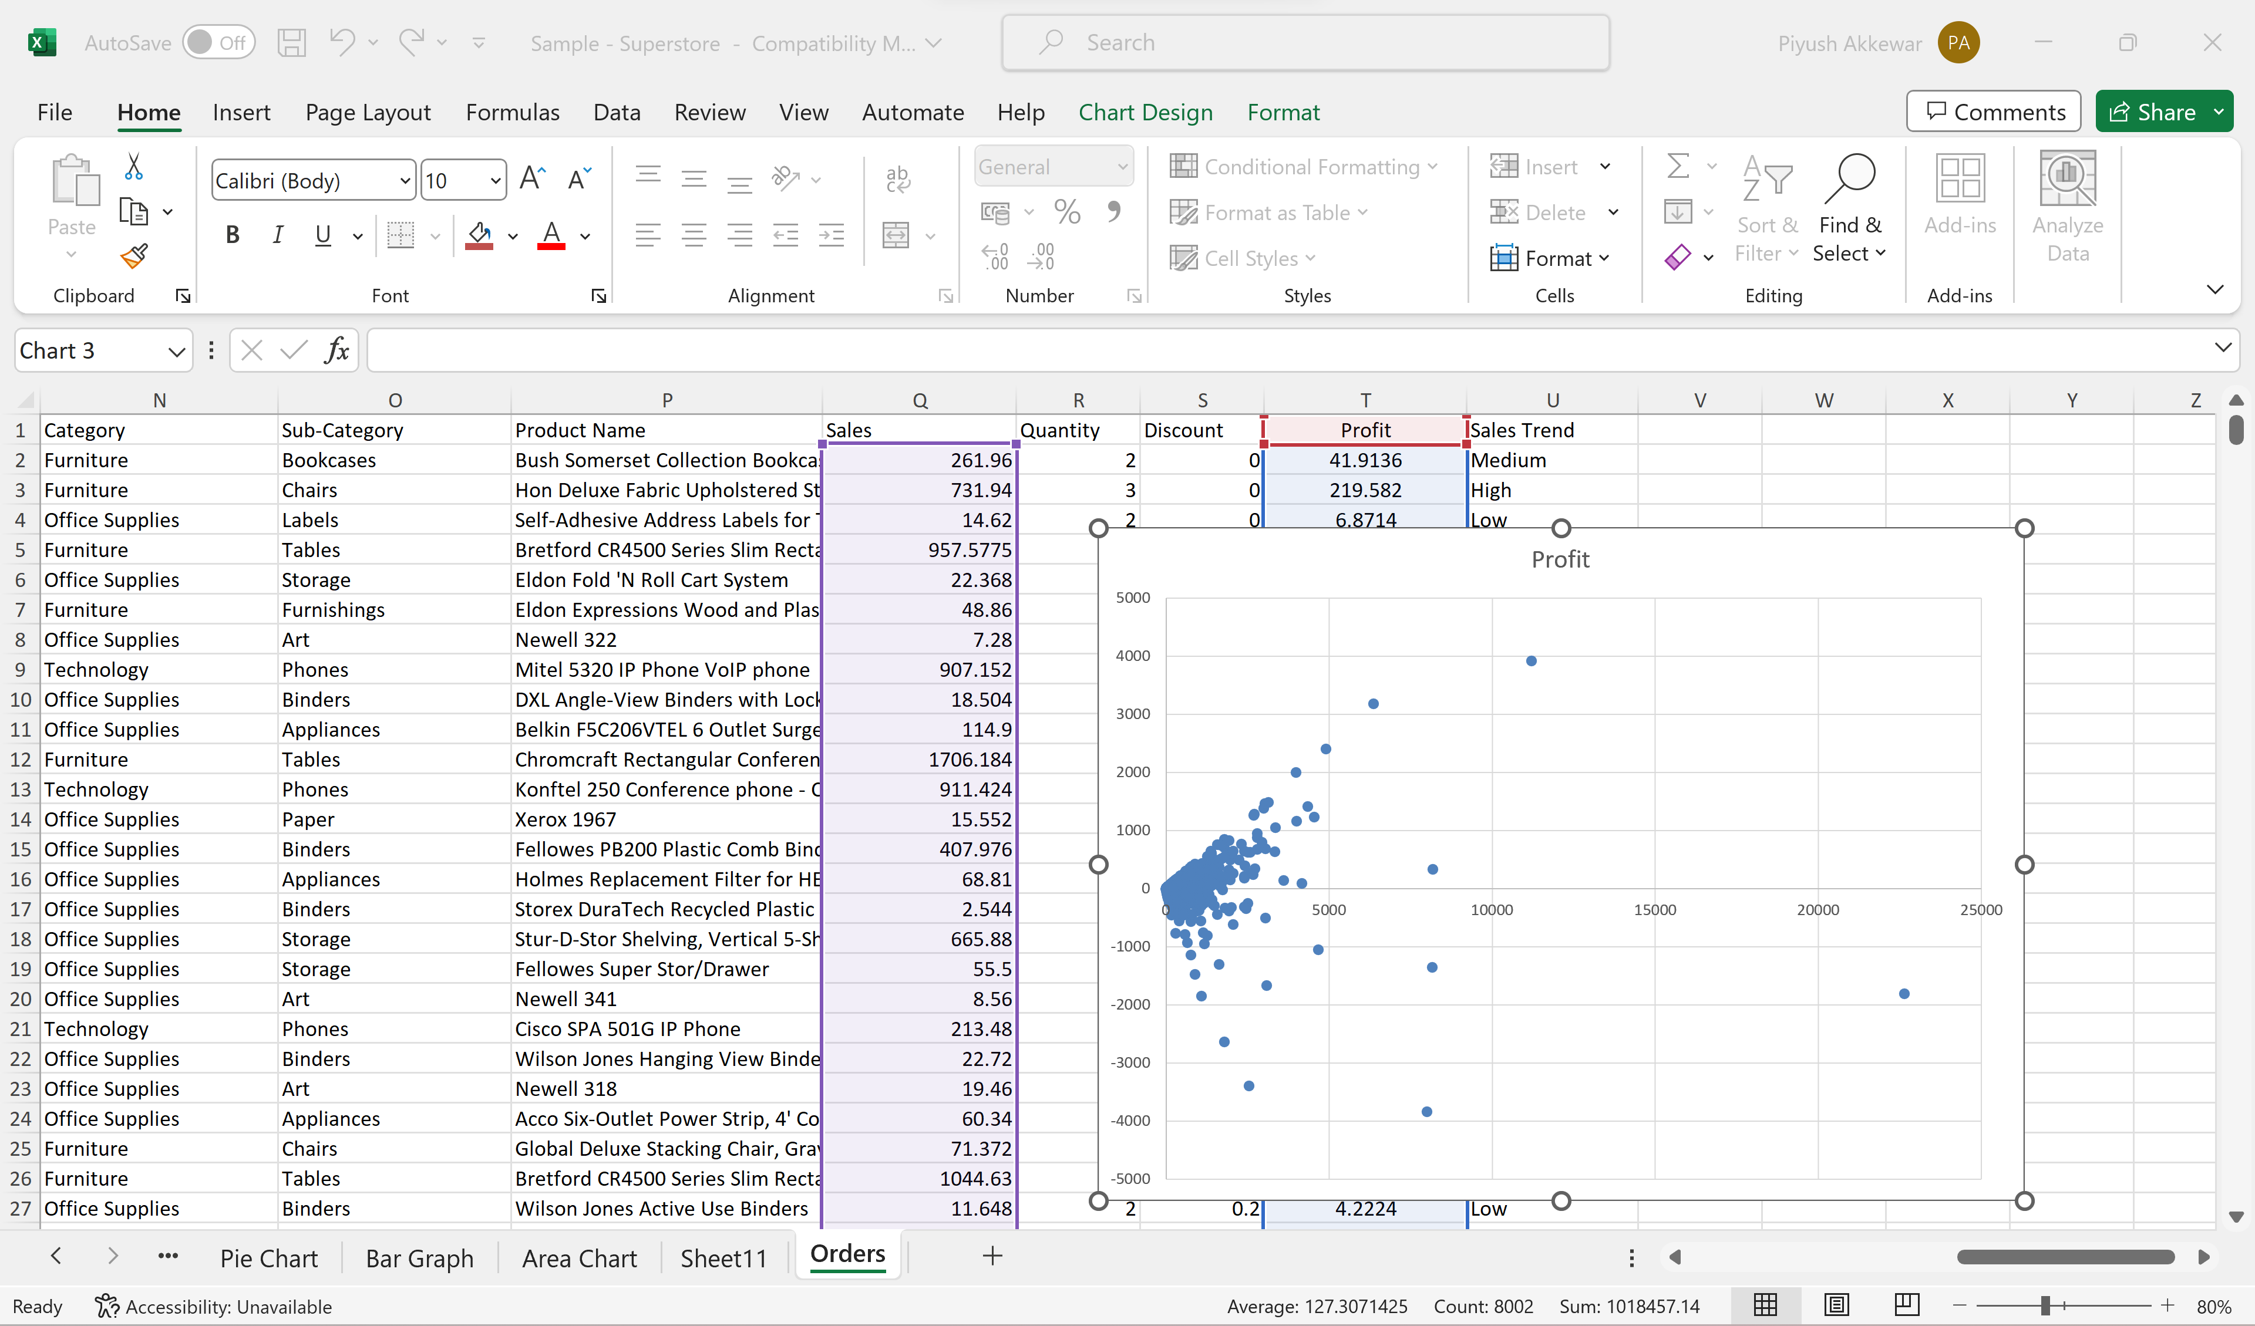
Data Visualization in Excel
Scatter Charts:
Ideal for exploring relationships between two variables
Scatter plots reveal patterns and correlations.
Easily identify outliers and clusters.
Select Columns; 'Sales' & "Profit', then insert scatter formula
Notes:
# Question 1: if statement
number = int(input("Enter a number: "))
if number > 0:
print("The number is positive.")
# Question 2: if-else statement
age = int(input("Enter your age: "))
if age >= 18:
print("You are eligible to vote.")
else:
print("You are not eligible to vote.")
# Question 3: if-elif-else statement
score = int(input("Enter your test score: "))
if score >= 90:
print("Your grade is A.")
elif score >= 80:
print("Your grade is B.")
elif score >= 70:
print("Your grade is C.")
elif score >= 60:
print("Your grade is D.")
else:
print("Your grade is F.")
# Question 4: Nested conditional statements
number = int(input("Enter a number: "))
if number > 0:
if number % 2 == 0:
print("The number is even and positive.")
else:
print("The number is odd and positive.")
elif number < 0:
if number % 2 == 0:
print("The number is even and negative.")
else:
print("The number is odd and negative.")
else:
print("The number is zero.")

Slide 21
Multiple Sheets in Excel
Create New Sheets: Add new sheets for data organization. Click the "+" icon next to the sheet tabs at the bottom, or right-click an existing sheet tab and select "Insert" to add a new sheet.
Rename Sheets: Give sheets meaningful names for clarity. Right-click on a sheet tab
Move or Copy Data: Easily transfer data between sheets.
Use Hyperlinks: Insert hyperlinks for quick navigation between sheets
Notes:
# Question 1: if statement
number = int(input("Enter a number: "))
if number > 0:
print("The number is positive.")
# Question 2: if-else statement
age = int(input("Enter your age: "))
if age >= 18:
print("You are eligible to vote.")
else:
print("You are not eligible to vote.")
# Question 3: if-elif-else statement
score = int(input("Enter your test score: "))
if score >= 90:
print("Your grade is A.")
elif score >= 80:
print("Your grade is B.")
elif score >= 70:
print("Your grade is C.")
elif score >= 60:
print("Your grade is D.")
else:
print("Your grade is F.")
# Question 4: Nested conditional statements
number = int(input("Enter a number: "))
if number > 0:
if number % 2 == 0:
print("The number is even and positive.")
else:
print("The number is odd and positive.")
elif number < 0:
if number % 2 == 0:
print("The number is even and negative.")
else:
print("The number is odd and negative.")
else:
print("The number is zero.")

Slide 22
Multiple Sheets in Excel
Navigating Between Sheets:
Sheet Tabs: At the bottom of the Excel window, you'll find sheet tabs. Click on a tab to switch to that sheet.
Keyboard Shortcuts: You can use keyboard shortcuts to navigate. For example, Ctrl+Page Up moves to the previous sheet, and Ctrl+Page Down moves to the next sheet.
Notes:
# Question 1: if statement
number = int(input("Enter a number: "))
if number > 0:
print("The number is positive.")
# Question 2: if-else statement
age = int(input("Enter your age: "))
if age >= 18:
print("You are eligible to vote.")
else:
print("You are not eligible to vote.")
# Question 3: if-elif-else statement
score = int(input("Enter your test score: "))
if score >= 90:
print("Your grade is A.")
elif score >= 80:
print("Your grade is B.")
elif score >= 70:
print("Your grade is C.")
elif score >= 60:
print("Your grade is D.")
else:
print("Your grade is F.")
# Question 4: Nested conditional statements
number = int(input("Enter a number: "))
if number > 0:
if number % 2 == 0:
print("The number is even and positive.")
else:
print("The number is odd and positive.")
elif number < 0:
if number % 2 == 0:
print("The number is even and negative.")
else:
print("The number is odd and negative.")
else:
print("The number is zero.")

Slide 23
Multiple Sheets in Excel
Grouping and Ungrouping Sheets:
Group Sheets: Hold Ctrl, select sheets, and right-click to group them.
Ungroup Sheets: Right-click on a tab in the group to ungroup.
Notes:
# Question 1: if statement
number = int(input("Enter a number: "))
if number > 0:
print("The number is positive.")
# Question 2: if-else statement
age = int(input("Enter your age: "))
if age >= 18:
print("You are eligible to vote.")
else:
print("You are not eligible to vote.")
# Question 3: if-elif-else statement
score = int(input("Enter your test score: "))
if score >= 90:
print("Your grade is A.")
elif score >= 80:
print("Your grade is B.")
elif score >= 70:
print("Your grade is C.")
elif score >= 60:
print("Your grade is D.")
else:
print("Your grade is F.")
# Question 4: Nested conditional statements
number = int(input("Enter a number: "))
if number > 0:
if number % 2 == 0:
print("The number is even and positive.")
else:
print("The number is odd and positive.")
elif number < 0:
if number % 2 == 0:
print("The number is even and negative.")
else:
print("The number is odd and negative.")
else:
print("The number is zero.")

Slide 24
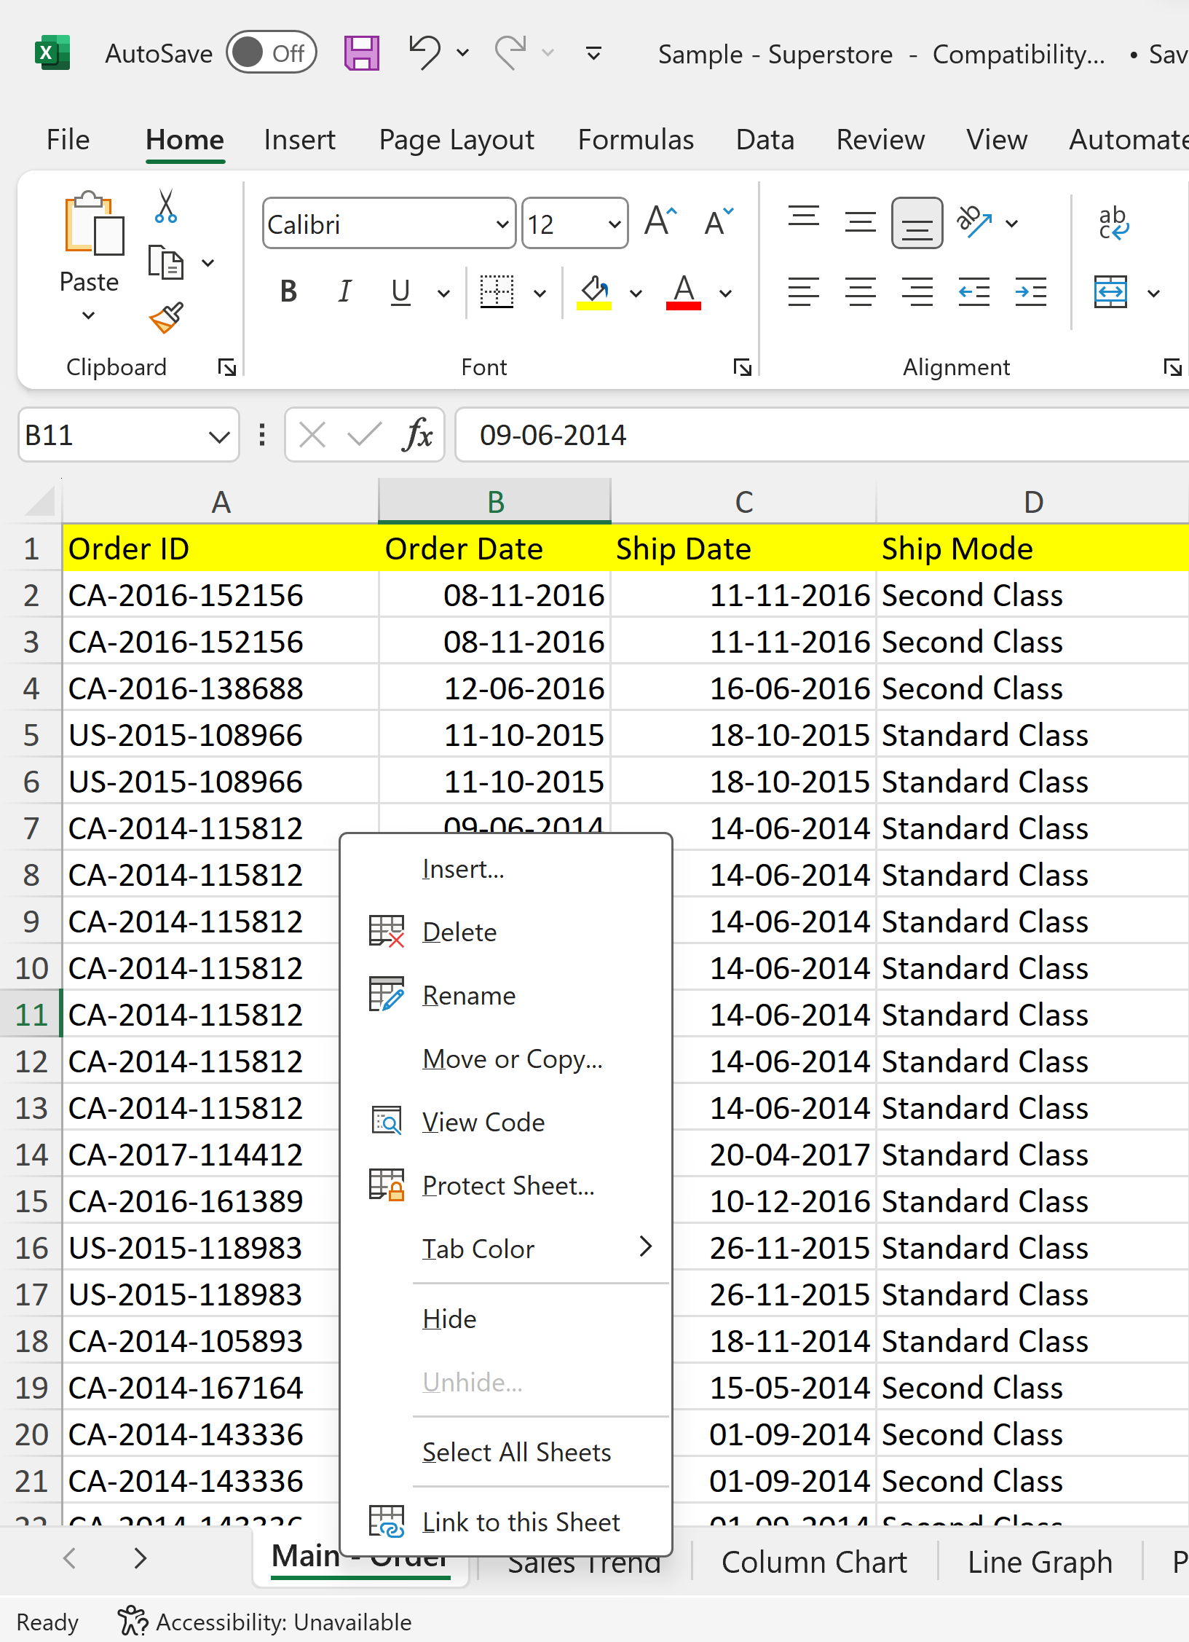
Multiple Sheets in Excel
Right Click on Sheet Name
Protecting Sheets:
Sheet Protection: Prevent unauthorized changes by setting passwords and access rights.
Protect Workbook: Safeguard the entire workbook to control sheet additions or deletions.
Notes:
# Question 1: if statement
number = int(input("Enter a number: "))
if number > 0:
print("The number is positive.")
# Question 2: if-else statement
age = int(input("Enter your age: "))
if age >= 18:
print("You are eligible to vote.")
else:
print("You are not eligible to vote.")
# Question 3: if-elif-else statement
score = int(input("Enter your test score: "))
if score >= 90:
print("Your grade is A.")
elif score >= 80:
print("Your grade is B.")
elif score >= 70:
print("Your grade is C.")
elif score >= 60:
print("Your grade is D.")
else:
print("Your grade is F.")
# Question 4: Nested conditional statements
number = int(input("Enter a number: "))
if number > 0:
if number % 2 == 0:
print("The number is even and positive.")
else:
print("The number is odd and positive.")
elif number < 0:
if number % 2 == 0:
print("The number is even and negative.")
else:
print("The number is odd and negative.")
else:
print("The number is zero.")

Slide 25
Linking & Referencing Data Between Worksheets
Importance of Data Linking:
Data linking connects information across different sheets.
It ensures consistency and minimizes data entry errors.
Allows for efficient data management and analysis
Notes:
# Question 1: if statement
number = int(input("Enter a number: "))
if number > 0:
print("The number is positive.")
# Question 2: if-else statement
age = int(input("Enter your age: "))
if age >= 18:
print("You are eligible to vote.")
else:
print("You are not eligible to vote.")
# Question 3: if-elif-else statement
score = int(input("Enter your test score: "))
if score >= 90:
print("Your grade is A.")
elif score >= 80:
print("Your grade is B.")
elif score >= 70:
print("Your grade is C.")
elif score >= 60:
print("Your grade is D.")
else:
print("Your grade is F.")
# Question 4: Nested conditional statements
number = int(input("Enter a number: "))
if number > 0:
if number % 2 == 0:
print("The number is even and positive.")
else:
print("The number is odd and positive.")
elif number < 0:
if number % 2 == 0:
print("The number is even and negative.")
else:
print("The number is odd and negative.")
else:
print("The number is zero.")

Slide 26
Linking & Referencing Data Between Worksheets
Referencing Data between Sheets:
Use cell references to link data between sheets.
Example: To reference cell A1 in Sheet2, enter = Sheet2!A1 in Sheet1.
Changes in Sheet2 reflect in Sheet1 dynamically
Check Sheet:-
Notes:
# Question 1: if statement
number = int(input("Enter a number: "))
if number > 0:
print("The number is positive.")
# Question 2: if-else statement
age = int(input("Enter your age: "))
if age >= 18:
print("You are eligible to vote.")
else:
print("You are not eligible to vote.")
# Question 3: if-elif-else statement
score = int(input("Enter your test score: "))
if score >= 90:
print("Your grade is A.")
elif score >= 80:
print("Your grade is B.")
elif score >= 70:
print("Your grade is C.")
elif score >= 60:
print("Your grade is D.")
else:
print("Your grade is F.")
# Question 4: Nested conditional statements
number = int(input("Enter a number: "))
if number > 0:
if number % 2 == 0:
print("The number is even and positive.")
else:
print("The number is odd and positive.")
elif number < 0:
if number % 2 == 0:
print("The number is even and negative.")
else:
print("The number is odd and negative.")
else:
print("The number is zero.")

Slide 27
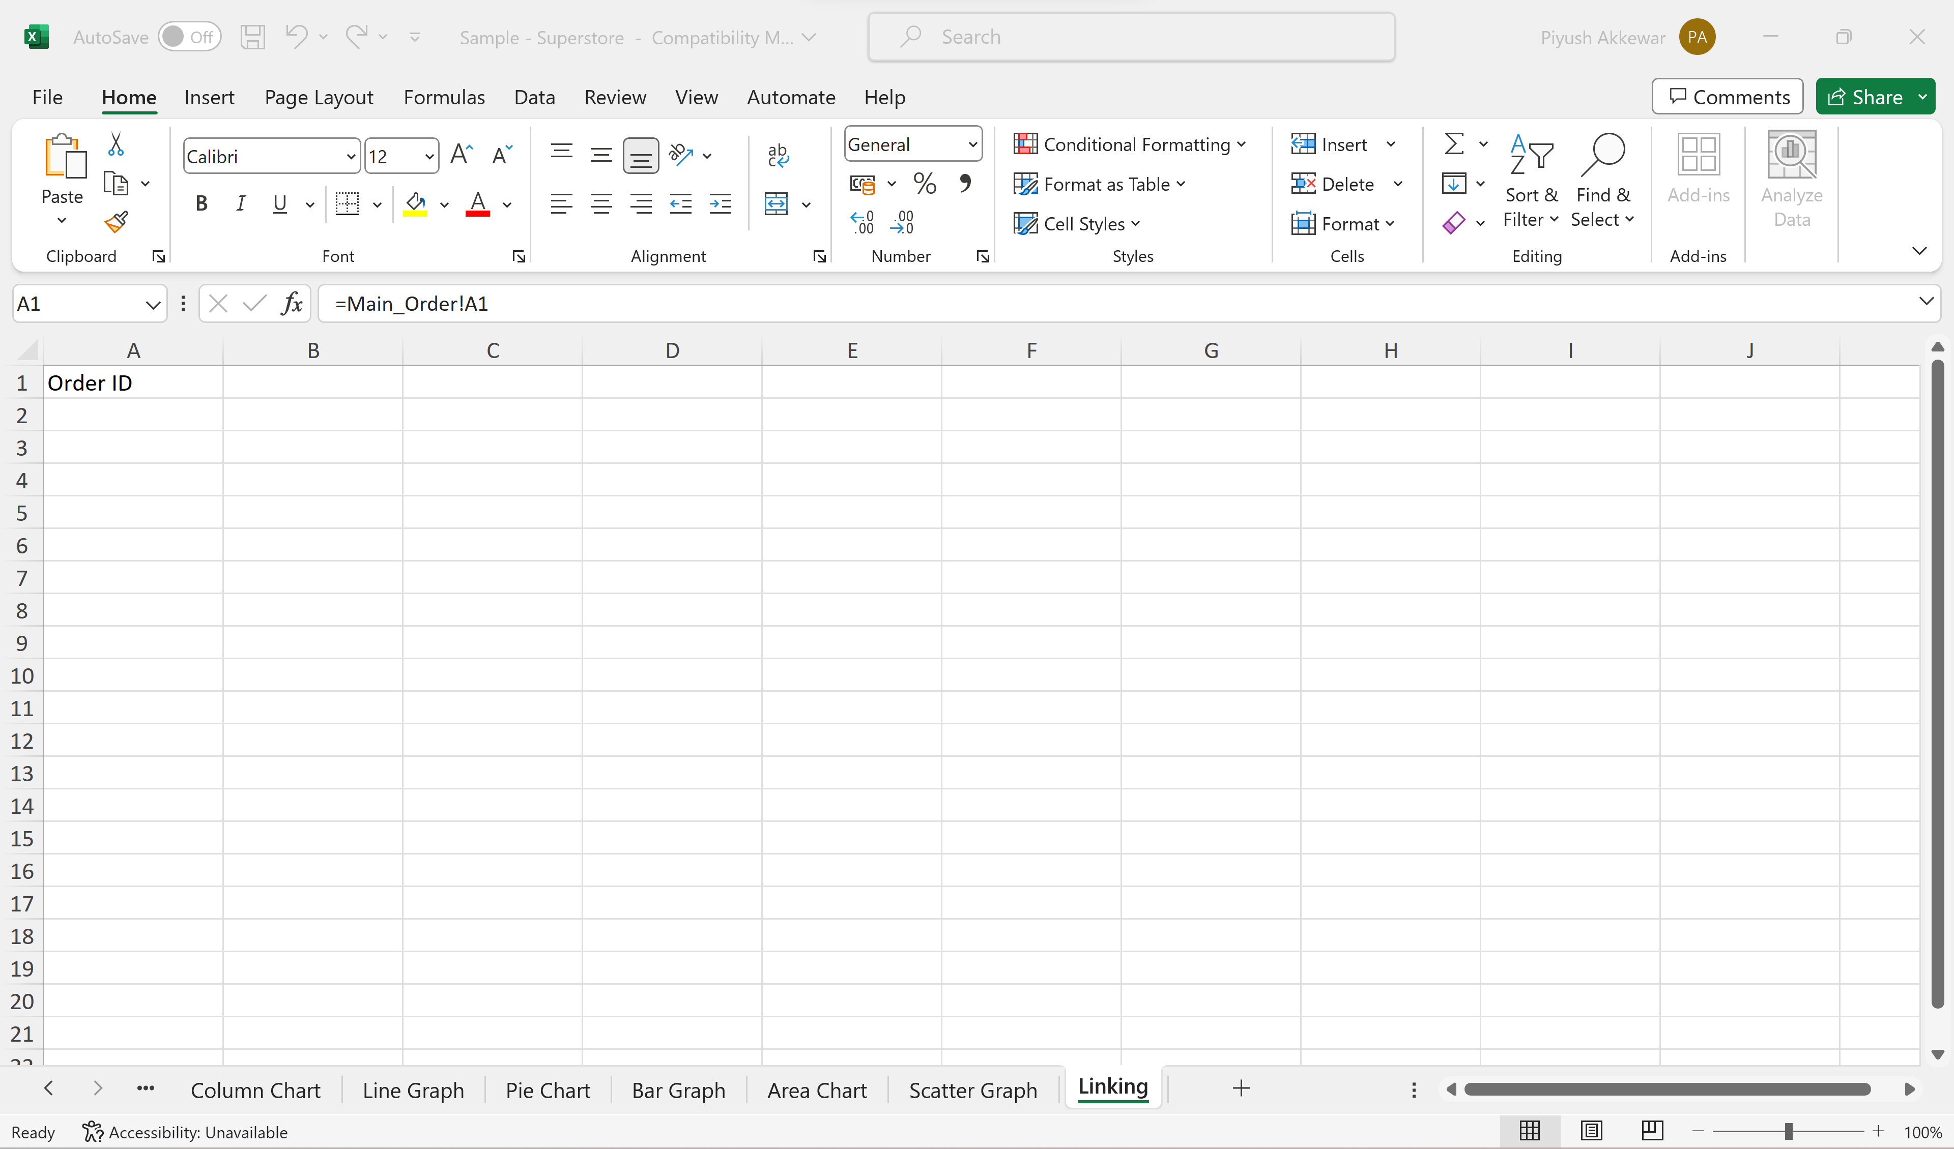
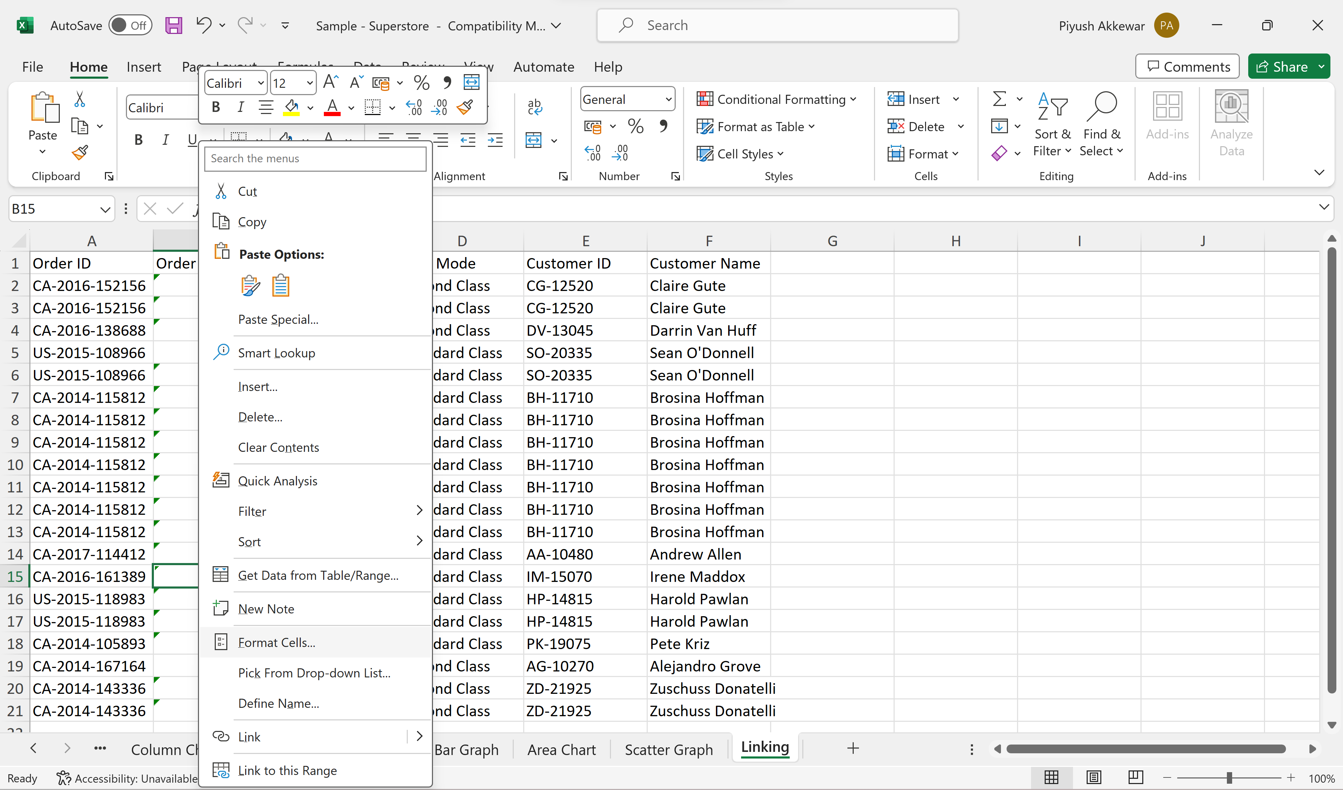
Linking & Referencing Data Between Worksheets
Linking Data from Different Sheet
Drag & Drop, & then Change Date format
Notes:
# Question 1: if statement
number = int(input("Enter a number: "))
if number > 0:
print("The number is positive.")
# Question 2: if-else statement
age = int(input("Enter your age: "))
if age >= 18:
print("You are eligible to vote.")
else:
print("You are not eligible to vote.")
# Question 3: if-elif-else statement
score = int(input("Enter your test score: "))
if score >= 90:
print("Your grade is A.")
elif score >= 80:
print("Your grade is B.")
elif score >= 70:
print("Your grade is C.")
elif score >= 60:
print("Your grade is D.")
else:
print("Your grade is F.")
# Question 4: Nested conditional statements
number = int(input("Enter a number: "))
if number > 0:
if number % 2 == 0:
print("The number is even and positive.")
else:
print("The number is odd and positive.")
elif number < 0:
if number % 2 == 0:
print("The number is even and negative.")
else:
print("The number is odd and negative.")
else:
print("The number is zero.")

Slide 28
Handson Exercise
Notes:
# Question 1: if statement
number = int(input("Enter a number: "))
if number > 0:
print("The number is positive.")
# Question 2: if-else statement
age = int(input("Enter your age: "))
if age >= 18:
print("You are eligible to vote.")
else:
print("You are not eligible to vote.")
# Question 3: if-elif-else statement
score = int(input("Enter your test score: "))
if score >= 90:
print("Your grade is A.")
elif score >= 80:
print("Your grade is B.")
elif score >= 70:
print("Your grade is C.")
elif score >= 60:
print("Your grade is D.")
else:
print("Your grade is F.")
# Question 4: Nested conditional statements
number = int(input("Enter a number: "))
if number > 0:
if number % 2 == 0:
print("The number is even and positive.")
else:
print("The number is odd and positive.")
elif number < 0:
if number % 2 == 0:
print("The number is even and negative.")
else:
print("The number is odd and negative.")
else:
print("The number is zero.")

Slide 29
Thank You!!!

